Slide 1
Report ExSFC
9th Meeting of the IECEx ExSFC
(Service Facility Certification Committee)
9th May 2023
Online Meeting

Slide 2
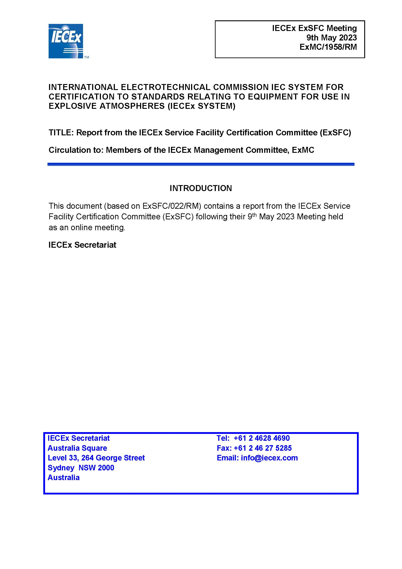

Slide 4
ExSFC Working Group 5 − Repair and Overhaul
The member endorsed the revision of
IECEx OD 313-5 Part 5: Repair, overhaul and reclamation of Ex equipment Assessment and Certification of Service Facilities involved in the repair, overhaul and reclamation of Ex equipment – Procedures Ed. 1.2

Slide 6
ExSFC Working Group 5 − Repair and Overhaul
The member endorsed the revision of
IECEx OD 314-5 Repair, overhaul and reclamation of Ex equipment Quality Management System requirements for IECEx Service Facilities involved in the repair, overhaul and reclamation of Ex equipment IECEx (Ed.2.1)

Slide 8
ExSFC Working Group 5 − Repair and Overhaul
The member endorsed the revision of
IECEx OD 315-5 Repair, overhaul and reclamation of Ex equipment Additional requirements for IECEx Service Facilities involved in the repair, overhaul and reclamation of Ex equipment Ed. 2.1

Slide 10
ExSFC Working Group 5 − Repair and Overhaul
An additional Annex is under consideration
IECEx OD 316-5 Repair, overhaul and reclamation of Ex equipment Assessment procedures for IECEx acceptance of Candidate Certification Bodies (ExCBs) for the purpose of issuing IECEx Certificates to Ex Service Facilities involved in the repair, overhaul and reclamation of Ex equipment. Ed. 1.1 Action 2023/01: New Annex regarding EXCB employed auditor competence requirements.

Slide 12
IECEx Certified Services Scheme
Submitted for approval
IECEx 03-2 Selection of Ex equipment and design of Ex installations – Rules of Procedure (Ed. 2.0)

Slide 14
IECEx Certified Services Scheme
Submitted for approval
IECEx 03-3 Ex installation and initial inspection – Rules of Procedure (Ed. 2.0)

Slide 16
IECEx Certified Services Scheme
Submitted for approval
IECEx 03-4 Ex inspection and maintenance – Rules of Procedure (Ed. 4.0)

Slide 18
IECEx Certified Services Scheme
Members considered a proposed revision of
IECEx 03-5 Repair, overhaul and reclamation of Ex equipment – Rules of Procedure (Ed. 1.3)
Action 2023/03: Revision of IECEx 03-5, Clause 8.1.3

Slide 19
Personal goal
Over the next two years, installation companies will be certified according to our IECEx Certified Service Scheme.
Advantages:
Stronger implementation of IEC 60079-14
Raising the quality
Massive reduction of the major faults (80% of faults could be avoided at no cost)

Slide 20
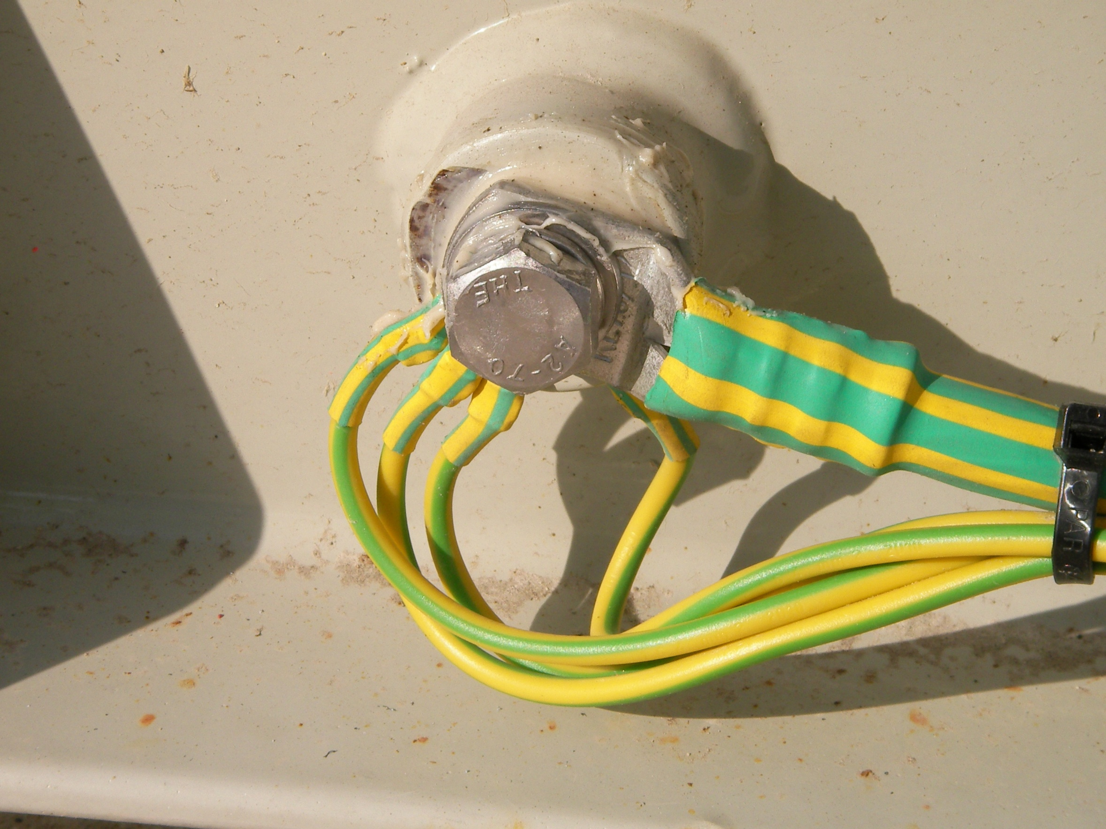

Slide 21
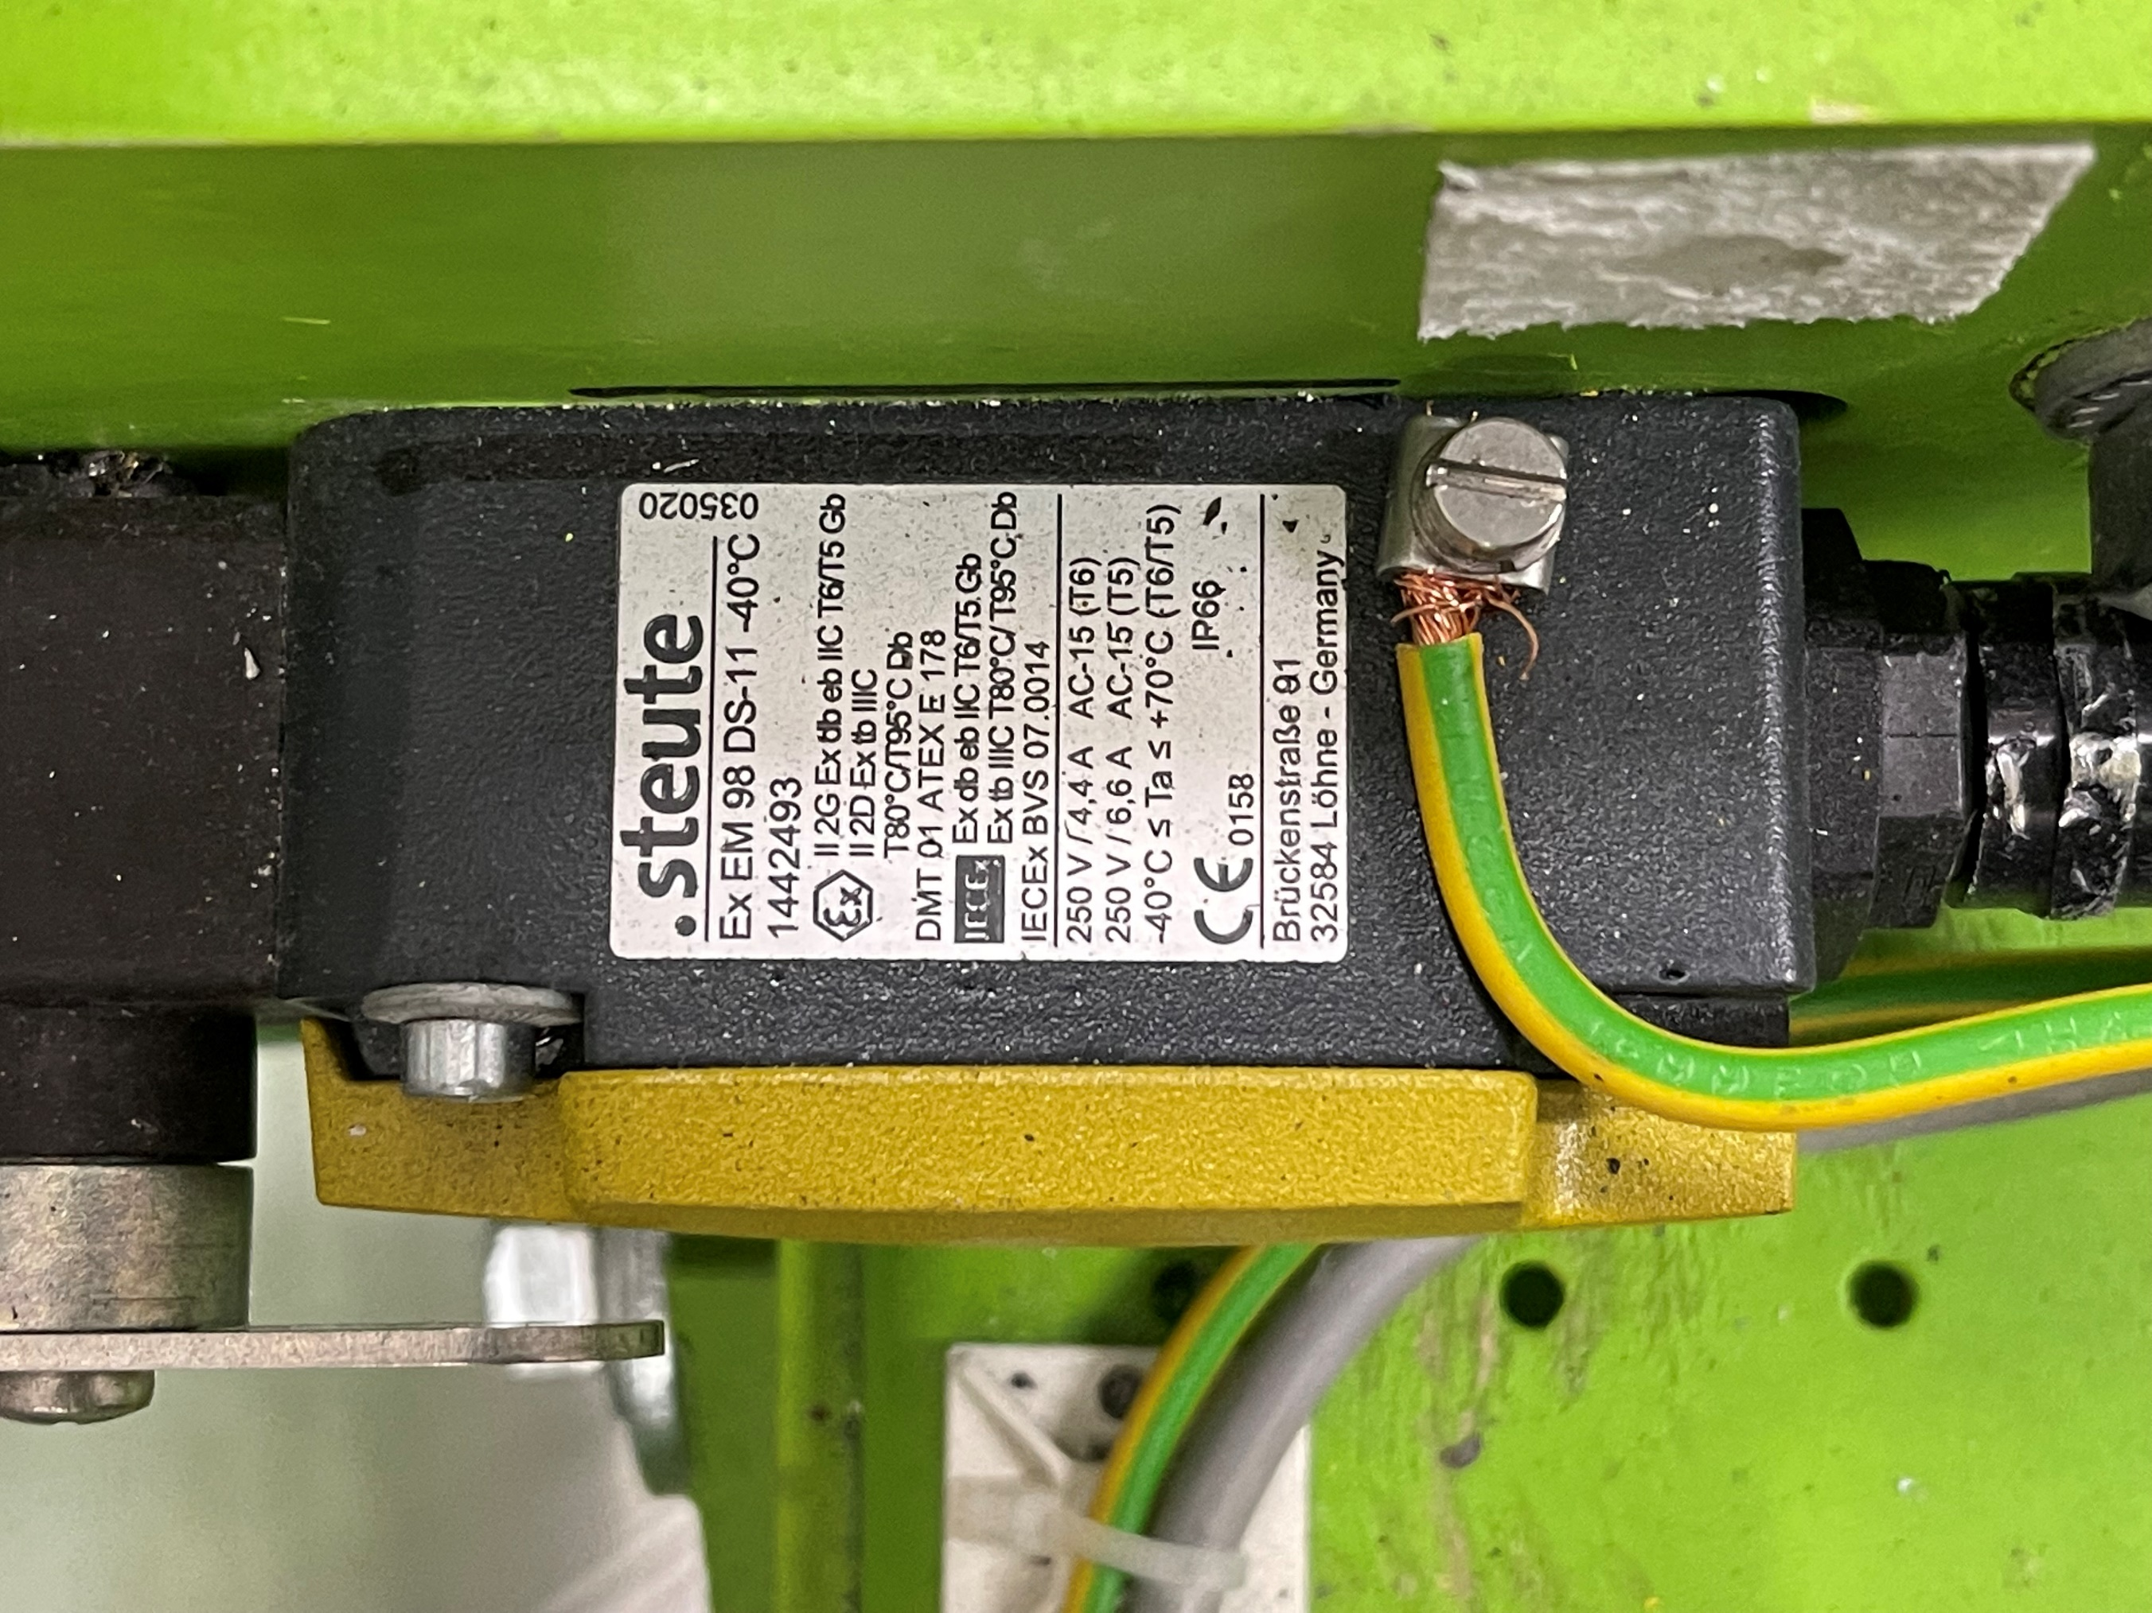

Slide 22
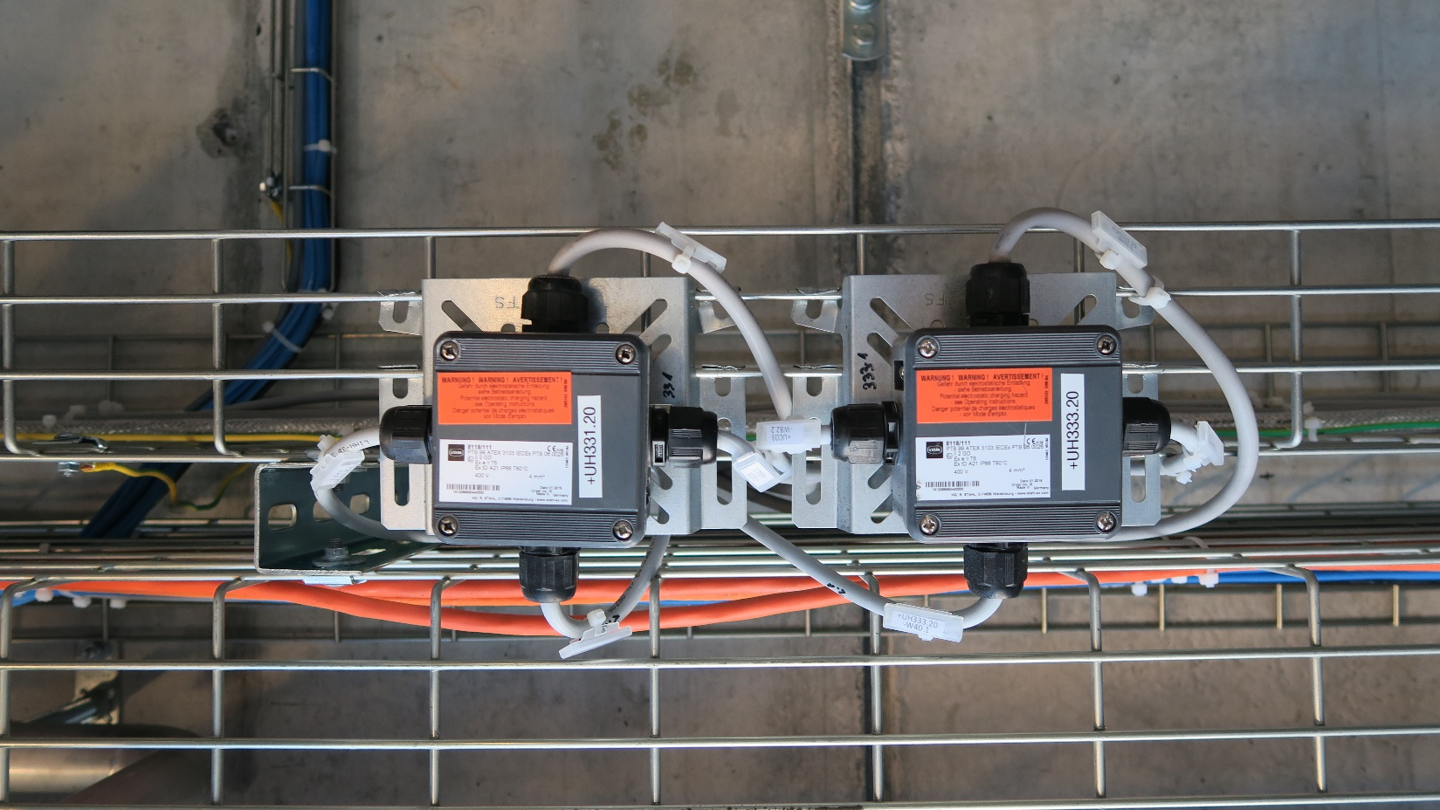

Slide 23
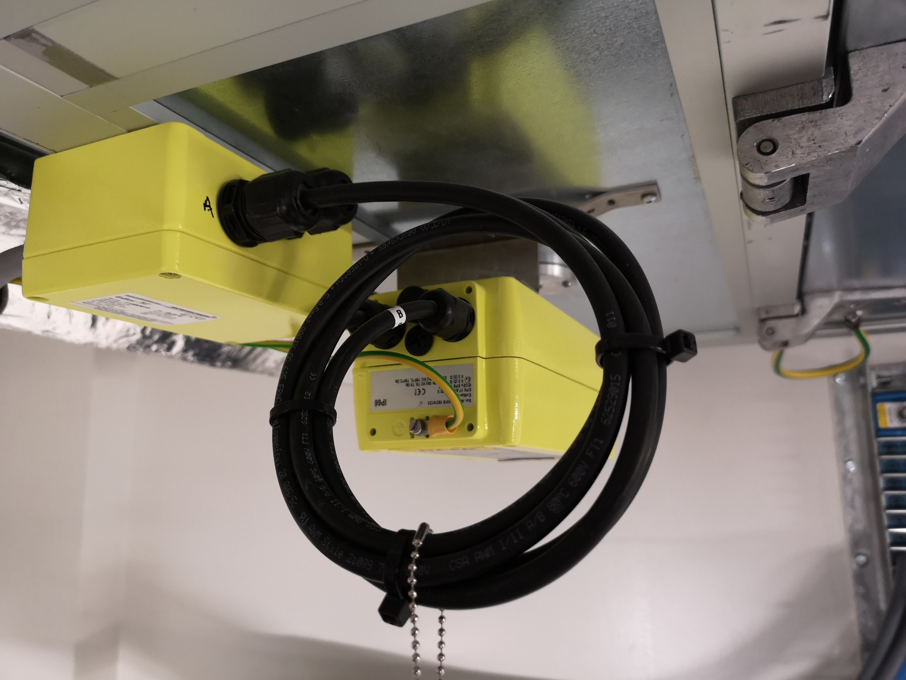

Slide 24
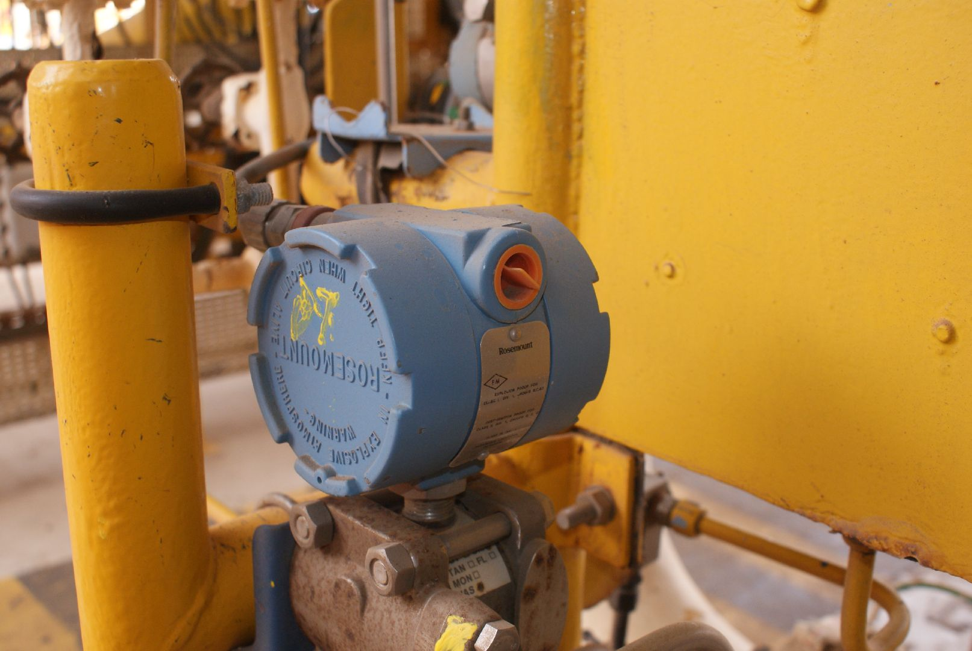

Slide 25
Do not forget − ExSFC Marketing

Slide 26
ExSFC Video

Slide 27
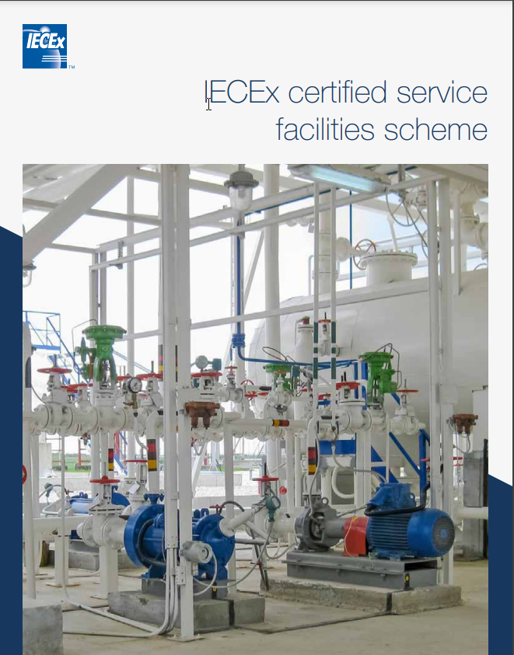
ExSFC Brochure

Slide 28
Thank you for your attention!

