Slide 1







IEC Global Impact Fund
Building a safer, more efficient and sustainable world by bringing the benefits of IEC International Standards and Conformity Assessment Systems to find solutions to some of the most pressing global challenges through scalable projects
  Build on the value IEC brings to society and highlight the positive impact it has on social, economic and environmental issues
  Increase awareness and understanding of IEC by engaging with stakeholders in an impactful partnership
  Champion energy efficiency, the renewable energy transition and next generation power systems
  Provide solutions and services for net zero, circular economy, and sustainable development
Notes:
The IEC Global Impact Fund continues to take shape in advancing the IEC vision of “a safer and more efficient world” and demonstrates the catalytic impact of international standards and conformity assessment systems in addressing many of today’s social, economic and environmental challenges and in ensuring that technology has a positive impact on society.
As a reflection of this commitment, the IEC launched the fund through a three-year annual contribution of 1% of its capital & reserves over the 2023-2025 pilot phase. This seed funding is helping to build a global public-private partnership for radical collaboration and collective action aligned with the IEC’s values and mission.

Slide 2
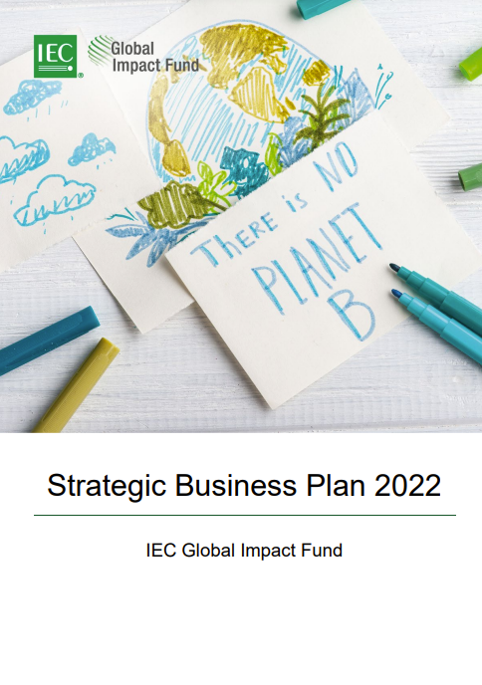
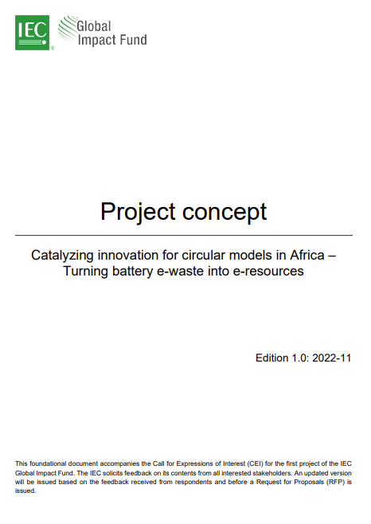
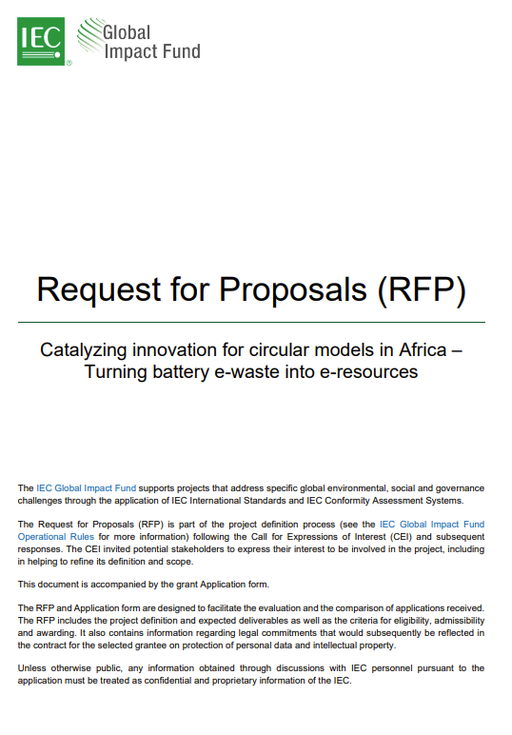
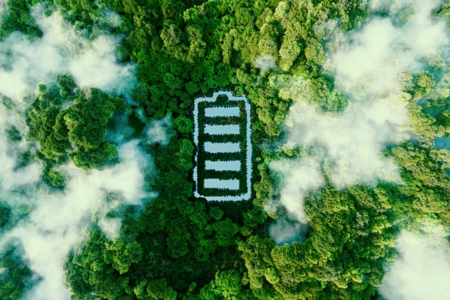
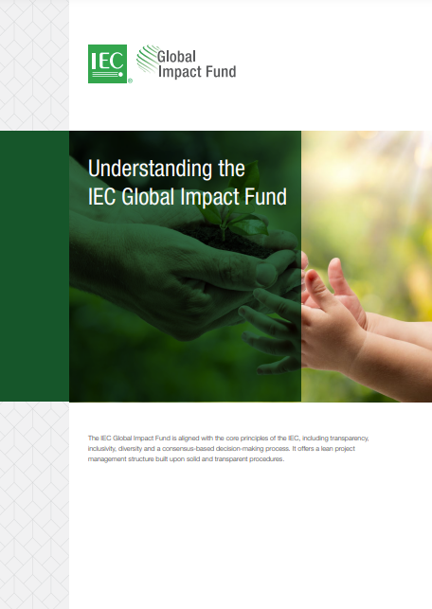
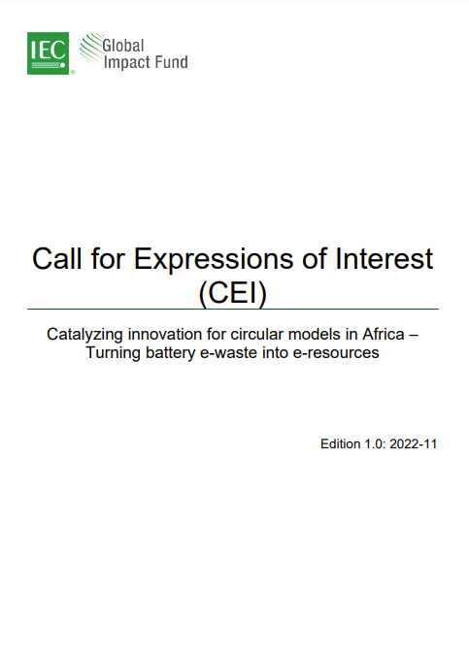
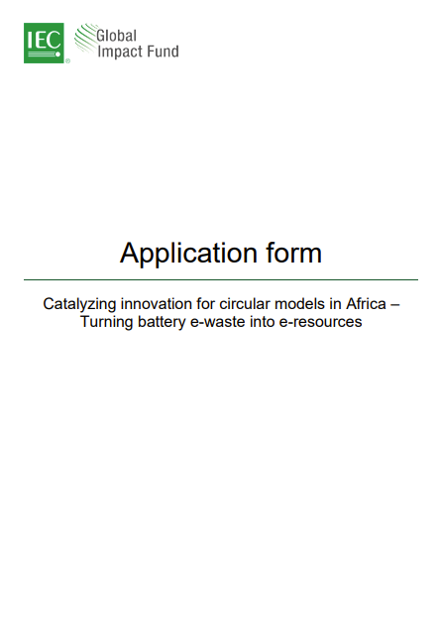
Concept to Reality
Catalysing Innovation for Circular Models in Africa -
Turning Battery E-Waste into E-Resources
https://www.iec.ch/global-impact-fund
Notes:
The start-up phase has involved establishing a governance, a small secretariat and a robust selection process for projects.
An important milestone was reached in June 2023 as the selection process for the first project was completed successfully and the contract signed with an SME chosen to implement a project that will analyse testing, safety of battery packs and second life pack building to provide reliable quality data which can be utilised for recommendations for standards and conformity assessment on second life lithium-ion battery products.

Slide 3




The Inaugural Project
Workshop
Battery Manufacture
Internal Battery Tests
External Battery Testing
Reproducibility Battery Testing
The project will consider standards and CA systems at all times, with an aim to create a test plan which can potentially be used as a standard throughout Africa. The Kenyan National Committee (NC) will provide feedback to ensure the test plans are realistic considering the capabilities of those likely to be carrying out such second-life battery testing.
IEC Standards
Notes:
Aceleron is an award-winning clean technology company that specialises in the design and development of battery packs using patented technology, facilitating the use of both first and second life cells, providing the opportunity to expand the cycle life of batteries and reducing the environmental burden of lithium-ion technology.
Built with the circular economy in mind, every part of their batteries is serviceable, upgradeable, and recyclable.
There will be involvement of several IEC National Committees (NCs) and consortium partners including GOGLA, the Schatz Energy Research Center and the National Physical Laboratory.

Slide 4
Milestones
Work Package | Milestones | Due Date
WP1 – Advisory board | Requirements for testing from initial workshop. Report on next steps for standardisation bodies and industry to progress the use of 2nd life batteries. | Q3-Q4 2023
WP2 – Battery manufacturing | Batch #1 of up to ten 2nd life batteries Batch #2 of up to ten 2nd life batteries | November-2023 November-2024
WP3 – Battery testing | Test results from Batch #1 2nd life battery packs Test results from Batch #2 2nd life battery packs | April-2024 April-2025
WP4 – Data management and software development | Data models and database available for cell and pack testing data. | May-2024
WP5 – Project management | Project kick off meeting Final project report | June-2023 May-2025
Notes:
The project will focus on how SME companies such as Aceleron can leverage the standardization and conformity assessment work of the IEC, provide a gap analysis of current test methods, as well as a review of current standards and how these might be best applied to second life batteries in Africa.

Slide 5
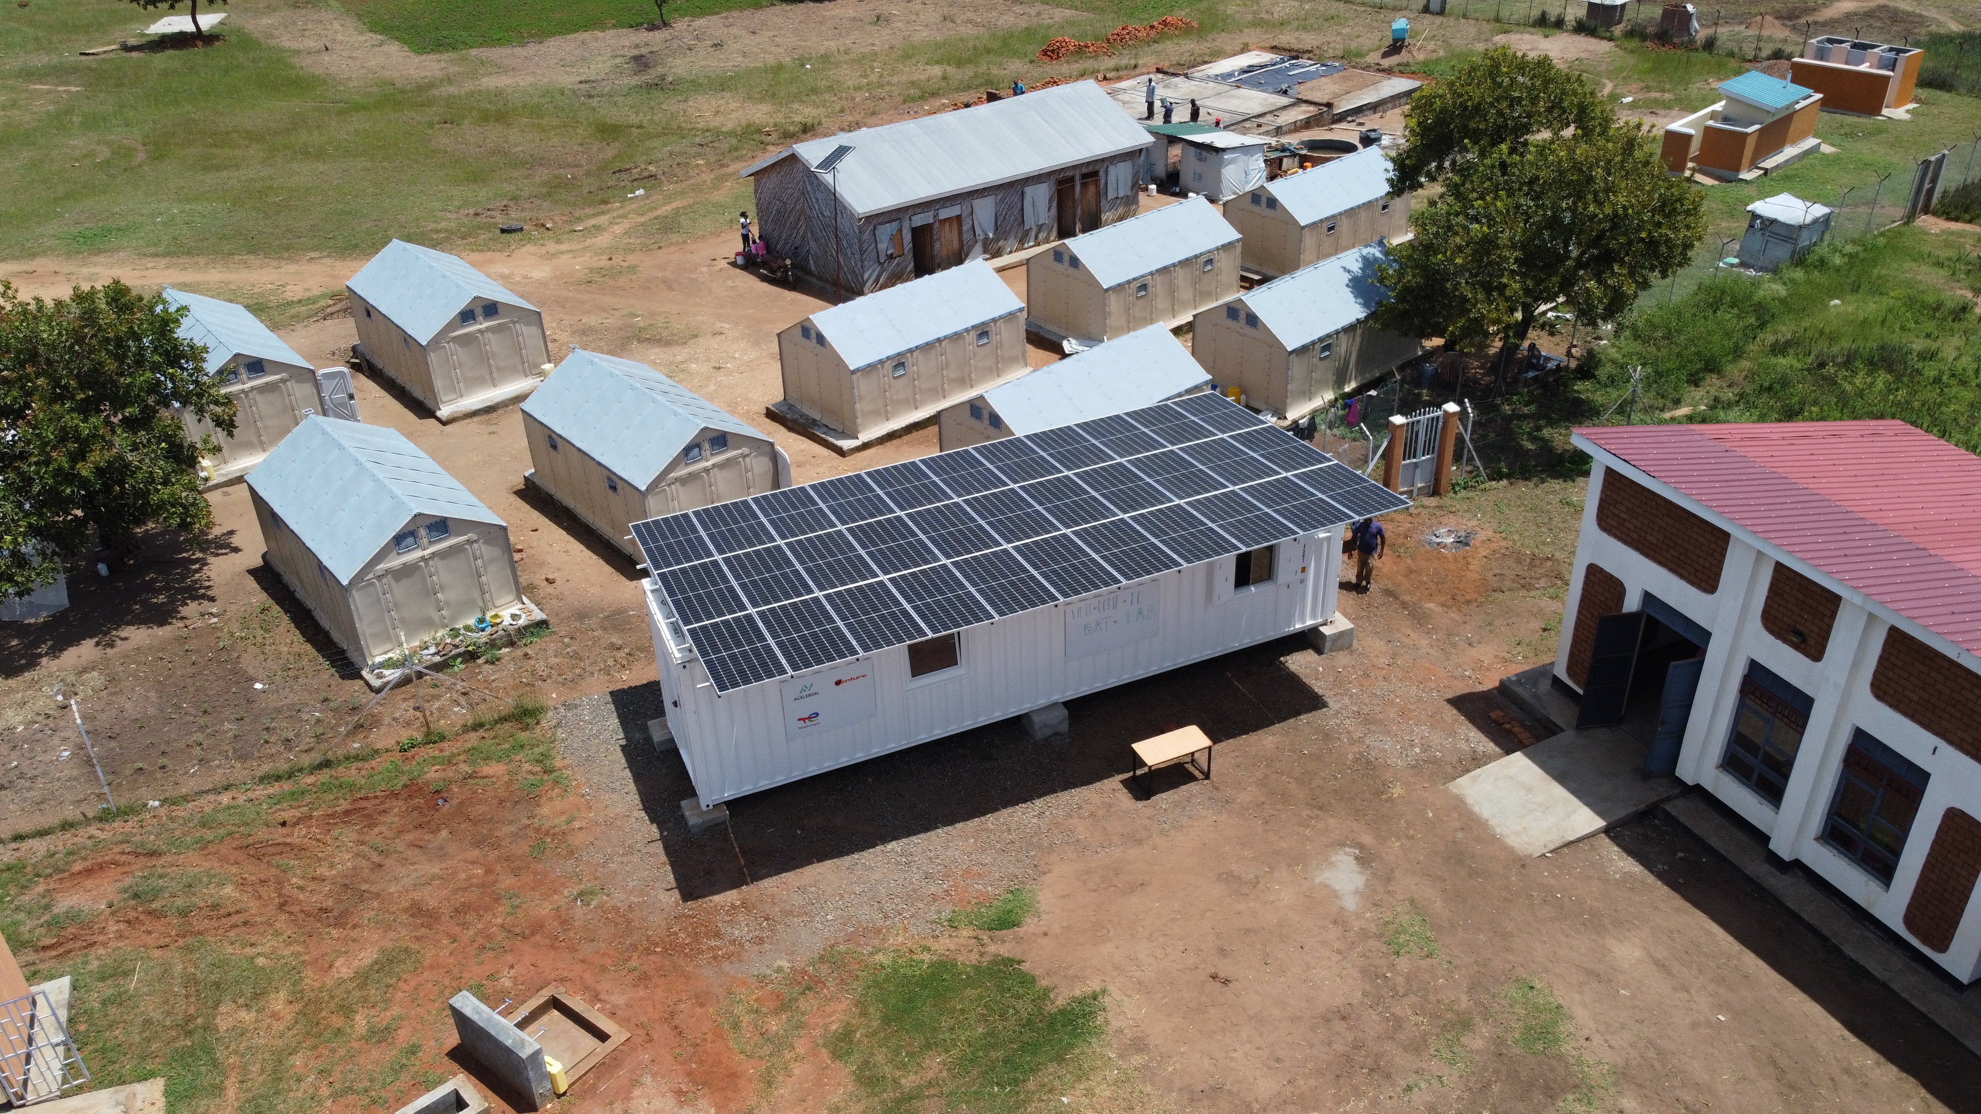
Notes:
The implementation of the project will take place in Kenya (see photo of the Aceleron site) and Uganda,
With energy storage as a critical component of energy access, the project will be a tangible example of the impact the IEC’s work can have on sustainable development and the energy transition.

Slide 6
2023 Priorities
  Develop first project concept, manage selection process and select implementing partner
  Accelerate discussions on long-term sustainable funding
  Develop identity and model that ensures return on investment for IEC and its stakeholders
Notes:
In parallel the IEC Global Impact Fund and partners will elevate the global level of ambition on the value that international standards and conformity assessment can bring to climate change, the energy transition and international development.

Slide 7
Partnership Network
Implementing Partner | Entities carrying out project work through the IEC Global Impact Fund, including SMEs, NGOs, and research institutions.
Knowledge Partner | Entities aligned with the social mission of the IEC Global Impact Fund
Enabling Partner | IEC NCs and other relevant stakeholders that support the IEC Global Impact Fund at national level and facilitate its engagement with others
Financing Partner | Entities that invest in the IEC Global Impact Fund
Notes:
The IEC Global Impact Fund will partner with other organisations, in various ways, based on a range of core principles. The specifics and partner criteria can be found on the IEC Global Impact Fund website.
Alignment of social mission
Alignment of purpose, objectives and goals
The potential to share benefits and risks
The potential to share costs and/or investments
The potential for joint governance and decision-making related to projects
Pooled resources, knowledge/ expertise/ know-how, facilities and networks (complementary and/or synergistic)
Balanced and mutual commitments
Joint recognition of the value of standards and conformity assessment in addressing social, economic and environmental challenges

Slide 8
globalimpactfund@iec.ch matthew.doherty@iec.ch

