Slide 1
ExPCC Projects – IECEx Question Bank
PROGRESS UPDATE

Slide 2
Project #1 – Assessment Management Software
A software tool or service for managing the content and use of the IECEx Question Bank for assessments in accordance with IECEx 05, IECEx OD 503 and IECEx OD 504
Tasks to be completed in parallel with tasks for Project #2:
The IECEx Executive has selected GetCertified as the software to be used for managing QBank content and management of IECEx CoPC and EFOC assessments (on-line or paperbased).
ExCBs will have access to the software as “Test Managers” to prepare and manage assessments based on the content of the reviewed and fixed IECEx Question Bank following completion of the following tasks:
Onboarding of IECEx Secretariat as Administrator for GetCertified software = Complete
IECEx Secretariat undergoes training in GetCertified to learn how to use so as to provide support and training to ExCBs = Complete
Loading of Q&A sets for Ex 000 into GetCertified = Complete
Training (mandatory) for all ExCBs on use of GetCertified with Q&A sets for Ex 000. >>> Planned completion = October 2021.

Slide 3
Project #1 – Assessment Management Software
IECEx Secretariat sets up access for all ExCBs as “Test Managers” = Complete
All ExCBs commence trial of GetCertified via mock assessments for Ex 000 >> ExCBs are invited to suggest any modifications needed >>> Planned completion = November 2021.
ExCBs choose to swap to GetCertified for some/all assessments for Ex 001 OR to use GetCertified in parallel with existing assessment methods for Ex 001 assessments >> from end of Nov 2021 … ExCBs are invited to suggest any modifications needed
ExCBs choose to swap to GetCertified for some/all assessments for some/all Units OR to use GetCertified in parallel with existing assessment methods for some/all assessments for some/all Units. This process to continue until further notice at which time ExCBs are invited to suggest any modifications needed to GetCertified prior to it being used by all ExCBs for all assessments
All ExCBs to commence use of GetCertified for all IECEx CoPC and EFOC assessments for all Units from date = To be discussed and agreed by ExPCC

Slide 4
Project #2 – Question Bank “Review & Fix”
The IECEx Executive has selected and IECEx has entered into an agreement with an external resource contracted to conduct the QBank Review & Fix Project using review criteria and acceptable fixes previously proposed by ExPCC WG3 and agreed by ExPCC. >>> Anticipated completion in 2021 Q4.
Loading of reviewed and fixed QBank for Ex 001 into GetCertified. >>> Anticipated completion by end of November 2021.
Loading of reviewed and fixed QBank for all other Units into GetCertified by Secretariat OR by YouTestMe staff at extra cost. >>>Anticipated completion by end of December 2021.

Slide 5


Slide 6
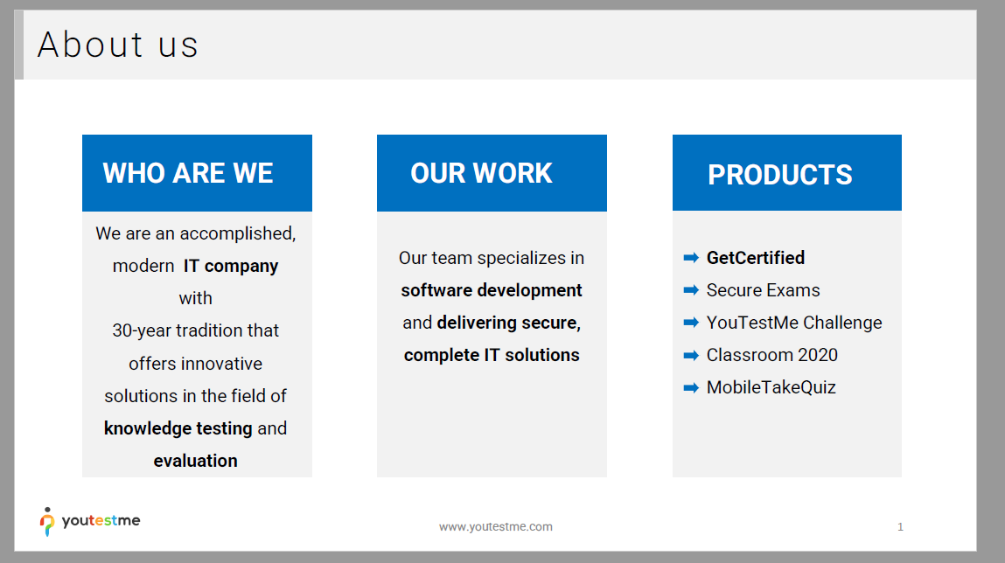

Slide 7
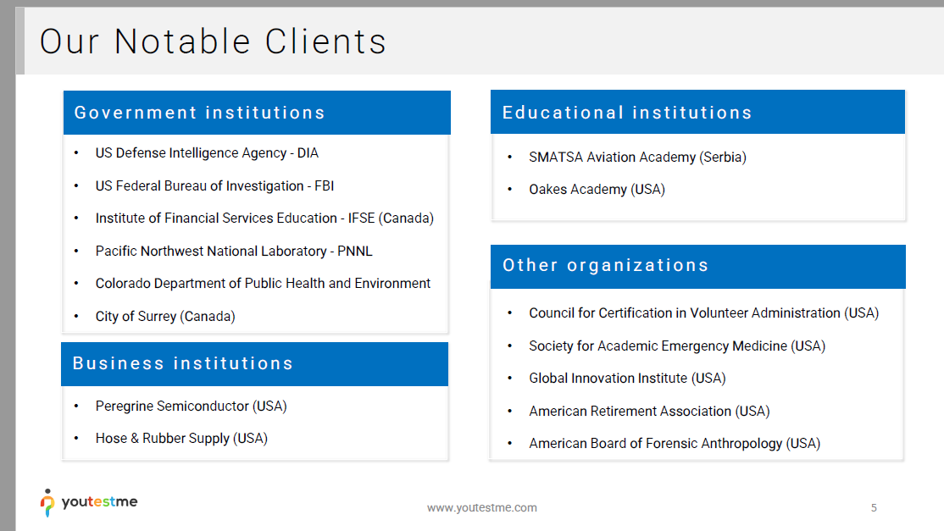

Slide 8
