Slide 1
IECEx Conformity Mark Committee (ExMarkCo) – IECEx ExMC 2021 Meeting Agenda Item 9
ExMarkCo Chair – Mr Timothy Duffy, US
September 2021

Slide 2
ExMarkCo – Report from the Chair
IECEx CONFORMITY MARK COMMITTEE (ExMarkCo)
9 IECEx Conformity Mark License Scheme, IECEx 04
9.1 Current List of IECEx Mark Licenses issuing ExCBs
9.2 Report from ExMarkCo Chairman
  Status of Revised Rules
  Change from the dual logo to single logo
  Updating of all IECEx publications
9.4 Current ExMarkCo Membership and vacancies
9.5 Notification of misuse of the IECEx Conformity Mark
9.6 Other Matters
9.3 Appointment of ExMarkCo Chair - will leave for the ExMC Chair to handle

Slide 3
9.1 Existing Mark Licensing ExCBs
Current ExCB Mark Licensing Bodies – 15 Total
  Australia – Safety in Mines Testing and Research Station (SIMTARS)
  Australia – TestSafe Australia
  Finland – Eurofins Expert Services Oy (EESF)
  France – Institut National de l'Environnement Industriel et des Risques (INERIS)
  France – Laboratories Central des industries Electriques International (LCIE)
  Germany – Physikalisch-Technische Bundesanstalt (PTB)
  Germany – TÜV SÜD Product Service GmbH (TÜV SÜD PS)
  Hungary – Hungarian Approval Service for Ex-proof Electrical Equipment (BKI)
  Netherlands – DEKRA Certification B.V. (DEKRA)
  Netherlands - KIWA
  Norway – NDV GL Presafe AS (PRE)
  United Kingdom – SGS BASEEFA Ltd (BASEEFA)
  United Kingdom – Intertek Testing and Certification Ltd (ITS)
  United Kingdom – SIRA Certification Service (SIRA)
  United Kingdom – Certification Management Limited (CML)
  As at August 2021 there are no new Applicants ExCBs for the IECEx 04 Scheme

Slide 4
9.2 Report from ExMarkCo Chairman
IECEx Conformity Mark Licenses @ 27 August 2021 = 42 total with 37 as Current (connected to 441 IECEx Certificates an increase compared to the 311 connected certificates reported in 2020)
Draft IECEx Conformity Mark Licenses = 12 compared to 9 as reported in 2020
Decision 2019/35 New Approach Current Members to note the Dubai 2019 ExMC Decision
Decision 2019/35
The meeting considered the content of the discussion paper circulated as ExMC/1521/CD- Concepts of New Approach for the IECEx Logo/ Trademark and IECEx Conformity Mark plus better integration with the IECEx Certified Equipment Scheme and supported Proposal Items 1, 2, 3, 4 and 5 outlined in ExMC/1521/CD and further requests ExMarkCo to continue its work towards streamlining access to the IECEx Conformity Mark and its practical use eg. shading, laser etc and use with small products

Slide 5

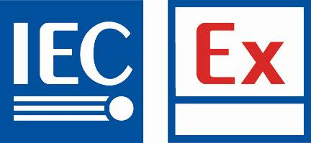
9.2 Report from ExMarkCo Chairman
Recap of Important Decision taken by ExMC, on New Approach
The agreed plan from the 2019 ExMC meeting (refer Decision 2019/35 on ExMC/1521/CD) was to have a single logo design that is to be used as (i) the IECEx Trademark / Brand and (ii) as the IECEx Conformity Mark on products. The logo is illustrated below:
The logo is being registered as the IECEx ‘device’
The text “IECEx” is being registered as the IECEx word mark
The single IECEx logo to replace the previously used IECEx Conformity Mark

Slide 6
9.2 Report from ExMarkCo Chairman
Implementation of ExMC Decision - Revised Publications now Complete and available
IECEx 04 Edition 2.0 >> “Regulations” to ‘Rules”, System” to “Scheme” (Approved by CAB) https://www.iecex.com/publications/iecex-rules/
IECEx OD 422 >> Mark Licenses issued to IECEx Certificate holding manufacturers by QAR issuing ExCB & revision of License Agreement format and terms https://www.iecex.com/publications/operational-od/
IECEx OD 423 >> previously known as OD 023 https://www.iecex.com/publications/operational-od/
IECEx Guide 01B, as per the proposed revision, continues to define who can use the IECEx logo in addition to details of how and where https://www.iecex.com/publications/guides/
IECEx Guide 04A, as per the proposed revision, explains how the IECEx logo can be used on products as the new IECEx Conformity Mark https://www.iecex.com/publications/guides/

Slide 7
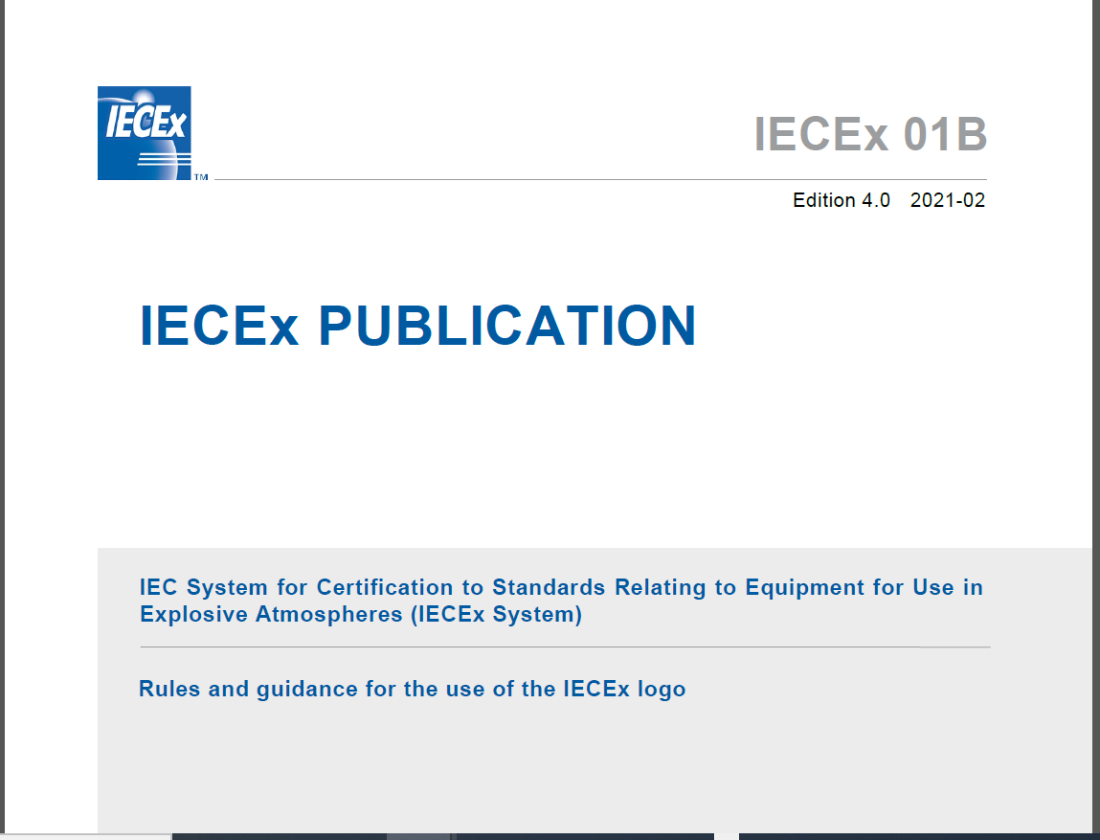


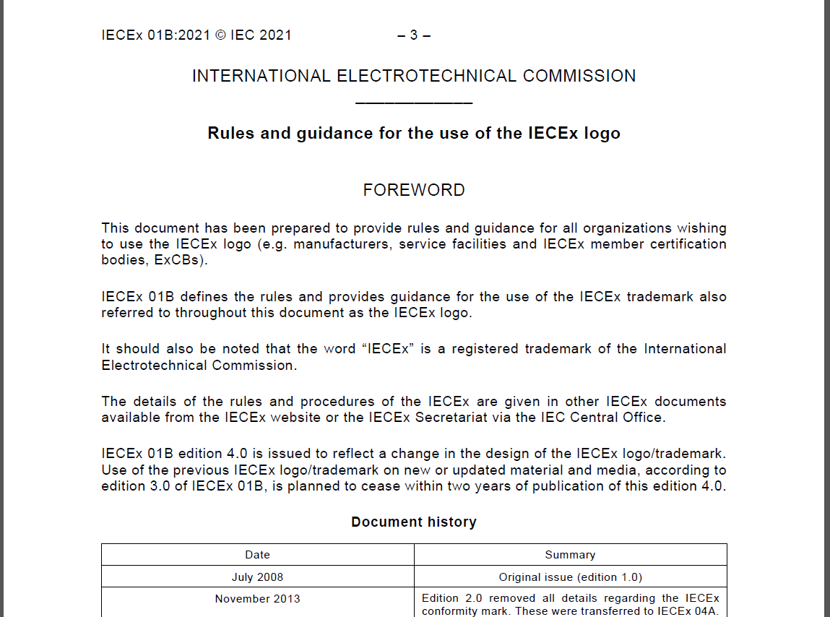
9.2 Report from ExMarkCo Chairman
Transition from previous dual logo to single logo on new or updated material and media – 2 years. Existing material not affected.
To ensure consistent IECEx Branding, all IECEx Rules, ODs etc have been re-issued with new single logo during 2021.

Slide 8
9.2 Report from ExMarkCo Chairman
IECEx Conformity Mark Licenses:
as issued to manufacturers by IECEx ExCBs that have an (optional and no fee) License Agreement with IEC …
Are NOT required if the IECEx logo is used in accordance with IECEx Guide 01B. NOTE that IECEx Guide 01B does NOT apply to, nor permit use of the IECEx logo on equipment, components or products
Are required if the IECEx logo is used in accordance with IECEx Guide 04A on equipment as a Conformity Mark to claim conformity with standards or specifications listed in an IECEx Certificate of Conformity.

Slide 9
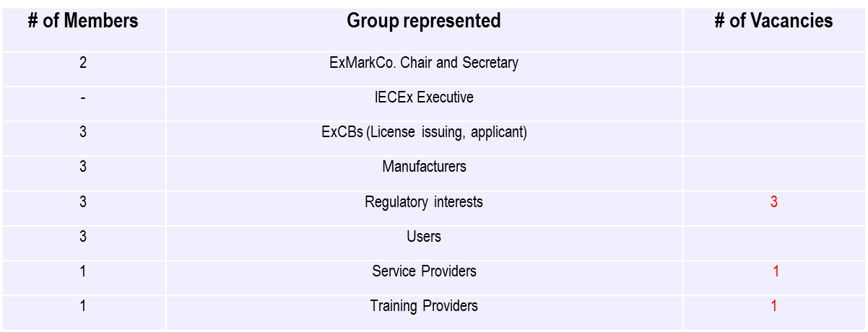
9.4 ExMarkCo membership
Membership in ExMarkCo/001R/INF at(to be updated to reflect changes in Executive)
http://www.iecex.com/docs/ExMarkCo_01I_Inf_Members.doc
The following vacancies still exist:
ExMC Members are requested to consider nominations for the other vacant positions.

Slide 10
9.4 ExMarkCo membership
Notification of misuse of the IECEx Conformity Mark and IECEx Logo
  At this stage there are no current significant matters requiring either ExMC or CAB involvement.
  Noting that the ExMarkCo Chair and IECEx Secretariat proactively monitor potential misuse
Members are asked to raise matters relating to misuse of the IECEx Conformity Mark and inform the Secretariat and ExMarkCo

Slide 11
9.5 Other Matters
Members are invited to raise any other matters relating to the IECEx Conformity Mark
***********************
Item 9.3 “Appointment of ExMarkCo Chair” – to be handled by IECEx Chair

Slide 12
Thank You

