Slide 1

IECEx Secretariat ExTAG Assessor Training- September 2020 Secretariat Compliance and the Desktop Review to Assist the Assessor Team – Surveillance and Re-assessment Audits

Slide 2


Secretariat Compliance ExTAG Assessor Training – 2020 Remote
This remote IECEx Secretariat ExTAG Assessor Training will review the following 4 Topics:
  QAR and CoC Statistics – 2020 YTD
  The Desktop Review (DTR) Edition 1 – commenced 2018 to assist the Assessment team on how ExCBs are managing their IECEx issued CoCs, QARs, ExTRs and their participation in the Proficiency Testing Scheme
  DTR Edition 2 – introduced in 2020 to address remote assessments of ExCBs and ExTLs incorporating key requirements of OD 060
  IECEx On-Line System (OCS) introduced October 2019 and includes new tools for the ExCBs to manage their issued CoCs, QARs, and ExTRs
    We will go online to view example OCS reports and tools

Slide 3
ExCB Management of QARs
The IECEx Certified Equipment Scheme is a Type 5 Product Certification Scheme modelled on (ISO/IEC 17067) that involves Surveillance including management system audits
The requirements of ExCBs operating in the IECEx Certified Equipment Scheme are based on ISO/IEC 17065 that includes requirements for Surveillance
  If the QAR summary has expired (validity date) then the manufacturer cannot claim that the product listed on the CoC linked to the expired QAR Summary are currently IECEx Certified (post validity date)
  The manufacturer MUST remain under surveillance to maintain the IECEx Certificate of Conformity for the product/s being produced at the manufacturing facility
  IECEx Certificates linked to ‘out of date’ QARs need to be dealt with and may include
    Up-issue to valid QAR
    Suspension until manufacturer is back under surveillance
    Cancellation
  The IECEx OCS backoffice tools highlight that many ExCBs do not manage their CoCs when linked to other ExCB QAR (slide 7 of this presentation)
Notes:
Suveillance audits to OD 025

Slide 4
Out of Date QARs - Status
Notes:
Remember that one out of date QAR may support several Certificates which are now technically invalid because the manufacturer is not under surveillance in accordance with IECEx Rules (refer Section 8.3 of IECEx 02) .
Green = 0 to 5 OofD QARs
Yellow = 5 to 15 OofD QARs
Red = >> 15 OofD QARs

Slide 5
Out of Date QARs - Status
Notes:
Remember that one out of date QAR may support several Certificates which are now technically invalid because the manufacturer is not under surveillance in accordance with IECEx Rules (refer Section 8.3 of IECEx 02) . 250 out of Date QARs could easily equate to over 1000 CoCs no longer supported, as a %, this is 3 to 5%
Should point out that sometimes the QAR cannot be forced off the list of ExCB1 because ExCB2 has not dealt with their CoCs linked to ExCB1 QAR..

Slide 6
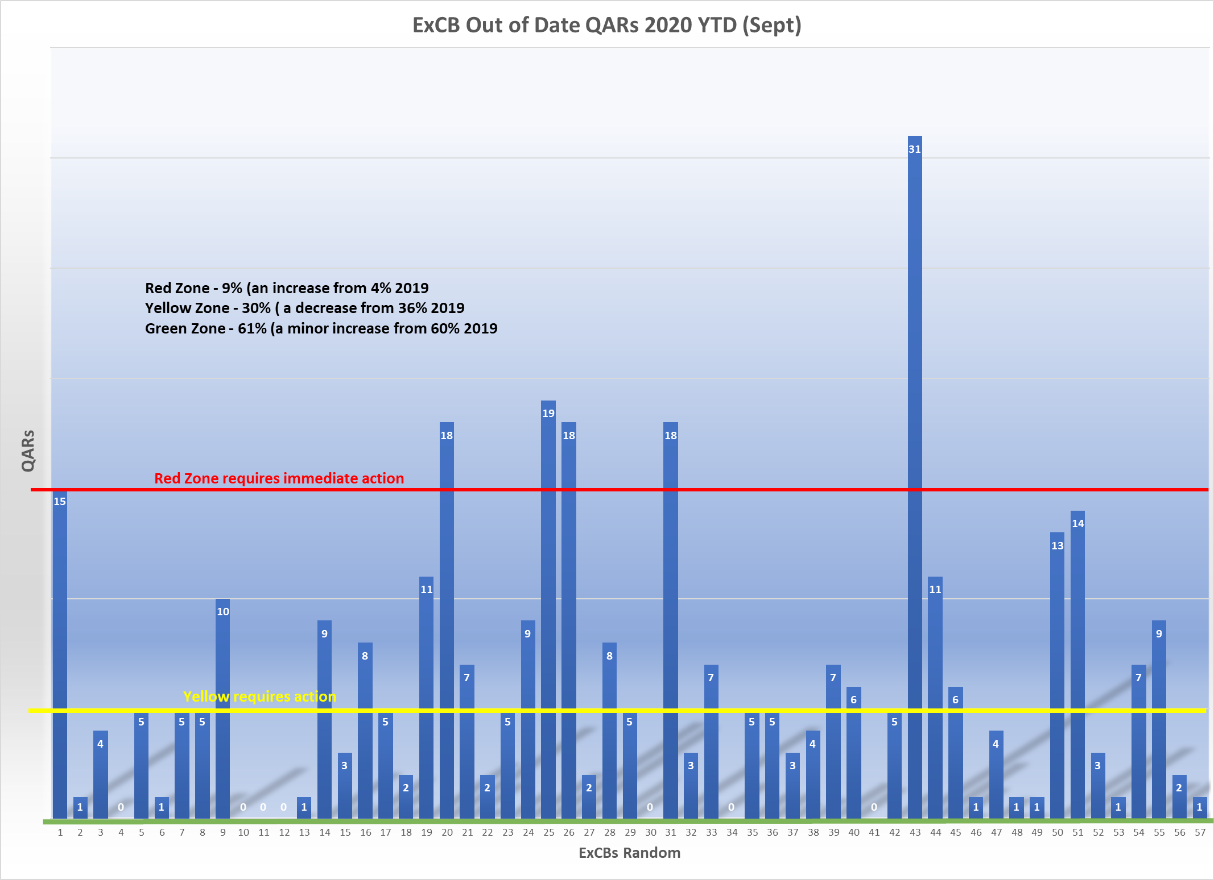
Out of Date QARs - 2020

Slide 7
CoCs linked to ‘out of date QARs’ – 2020

Slide 8

Essential reading for ExCB Staff
Operational Document IECEx OD 209
Requirements and Guidelines for the Suspension, Cancellation and Reinstatement of Certificates of Conformity
Operational Document IECEx OD 250
Guidance on the management of IECEx Quality Assessment Reports
[NOTE: this replaces ExTAG/164/INF and ExTAG/245/INF]
Operational Document IECEx OD 009
IECEx Certified Equipment Scheme, Procedures for the Issuing of IECEx Certificates of Conformity, IECEx Test Reports and IECEx Quality Assessment Reports
Operational Document IECEx OD 011 (Series)
Guidance on Use of the IECEx Internet based “On-Line” Certificate of Conformity System
Operational Document IECEx OD 060
IECEx Guide for Business Continuity – Management of Extraordinary Circumstances or Events Affecting IECEx Certification Schemes and Activities Ed.2

Slide 9
IECEx Secretariat Desktop Review (DTR)
DTR Edition 1 (introduced to assist the Assessor and highlight any issues on how the ExCB is managing its CoCs and QARs and other
DTR Edition 2 (introduced for remote assessments) as above but also includes a Risk Review and Declaration Form – Changes in Organization

Slide 10
IECEx Online CoC System
ExCBs can download reports in the IECEx OCS backoffice that:
  Provide a list of QARs out of date
  Provide a list of CoCs issued by the ExCB that are linked to other ExCBs QARs that are out of date
Go to the live website

Slide 11

IECEx Compliance Issues 02 Scheme

Slide 12
Out of Date QARs
Why do QARs go out of date?
  Surveillance or re-assessment no longer conducted or delayed by ExCB (internal process non existent or not used)
  Manufacturer may discontinue products (refer to OD 209 about Cancellation)
  Manufacturer selects a different ExCB to conduct the re-assessment, a new QAR is then generated and not all CoCs are up-issued to new QAR
  Manufacturer does not respond to ExCB to schedule surveillance or re-assessment (refer to OD 209 about Suspension/Cancellation)
Notes:
Surveillance and Re-assessments provide a continuous revenue stream for the CB and provide the manufacturer with a product that is 3rd party assessed –win/win (customer confidence)

