Slide 1
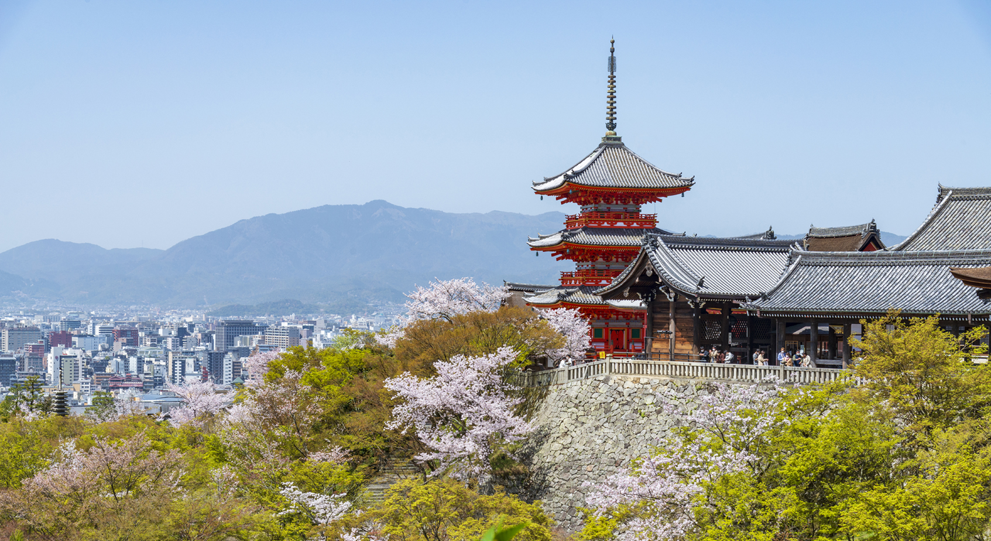
2025 Annual Meetings of the IECEx System
Kyoto Japan
Welcome & Key Information for Participants
15-19, Sep. 2025

Slide 2
Meeting & Event Schedule
 | 9/14(Sun) | 9/15(Mon) | 9/16(Tue) | 9/17(Wed) | 9/18(Thu) | 9/19(Fri)
9:00-12:00 |  | Assessor Training Session (Room B-1) | ExTAG (Room B-1) | ExSFC (Room B-1) | ExMC (Room B-1) | ExMC (Room B-1)
Before Lunch |  |  |  |  | Group Photo
Lunch Break |  |  | Hosted Lunch² (Swan) | Speaker’s Lunch³ (Grill) | Hosted Lunch² (Swan) | Hosted Lunch² (Swan)
13:00-17:00 | Registration¹ (14:00-17:00) | ExPCC (Room B-1) | ExTAG (Room B-1) | Industrial Symposium (Room B-1) | ExMC (Room B-1) | ExMC (Room B-1)
18:00-21:00 |  | WG (Room 552) | WG (Room 552) | WG (Room 552) | Dinner (Sakura)
Registration Desk hours
  Sunday: 14:00-17:00
  Monday to Friday: 8:30-17:00
Hosted Lunch provided for all participants on 16th, 18th and 19th Sep.
Speaker’s Lunch provided only for the Symposium speakers on 17th Sep.

Slide 3
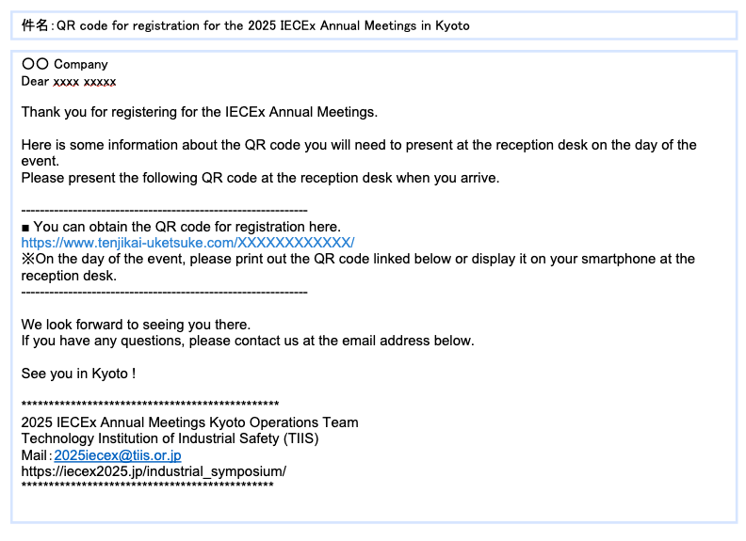
Important Notice: QR Code Required for Admission
Meeting registration will be conducted via QR code.
An email invitation containing a QR code will be sent to registrants at the beginning of September.
Participants are requested to follow the instructions in the email to access the QR code.
Please bring the QR code to the meeting venue, either on your smartphone screen or as a printed copy.
The QR code will be scanned at the registration desk, where you will receive a printed admission pass.
Note
The QR code invitation email will be sent from the following address:
2025iecex_kyoto@tenjikai-uketsuke.com
*Please ensure that emails from this address are not filtered into your spam or junk mail folder.
Invitation email

Slide 4
Conference and Event Rooms
Room | Purpose | Time | Date | Note
B-1 | Meetings and Industrial symposium | 8:00-18:00 | All days | Meals are NOT permitted in the room. Beverages and light snacks are allowed.
Break Area | Tea & Coffee Sponsor Exhibition Registration Desk | 8:00-18:00 | All days | Infront of B-1
552 | Working Group | 12:00-20:30 | 15th(Mon) | Food and beverages are permitted in the room.
 |  | 17:00-21:00 | 16th(Tue)
 |  | 17:30-20:00 | 17th(Wed)
Sakura | Dinner | 18:00-21:00 | 17th(Thu)
505 | Prayer room (Women) | 9:00-17:00 | All days | Free of charge, No booking required.
507 | Prayer room(Men)
Swan | Hosted Lunch | 12:00-13:00 | 16th(Tue), 18th(Thu), 19th(Fri) | Complimentary lunch provided.
Grill | Invitation-only Lunch for Symposium Speakers | 12:00-13:00 | 17th (Wed)

Slide 5
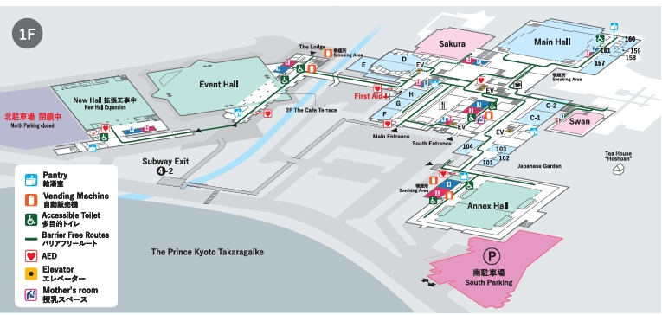
Floor Guide
ExMC Dinner
Ground floor
Cafe
Restaurant
Lunch

Slide 6
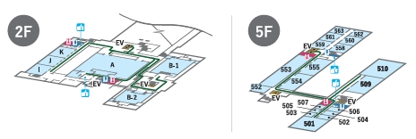
Floor Guide
Meeting Room B-1
1st Floor
4th Floor
Break Area
Registration Desk
Room 552
Prayer Room 505,507

Slide 7
Restaurant & Cafe
 | Open hours | Date
Cafe / The Grill | 10:00-17:00(Last Order: 16:30) *Lunch 11:00-15:00 | All days
Restaurant / NIWA café | 10:30-14:30(Last Order: 14:00) | 9th(Mon), 17th(Thu)

Slide 8
Cloakroom Service
A cloakroom service is available next to the central elevator on the ground floor, where you may leave your luggage and personal belongings.
Date | Service hours | Eligible Participants
Sep. 17th (Wed) | 10:00-18:30 | Symposium attendees
Sep. 19th (Fri) | 8:30-17:30 | Departing participants

Slide 9
Wi-Fi Information
Room | For | SSID | PASSWORD
B-1 | IECEx Secretariat | ex_meeting_sys | * Not for attendee use
B-1 and Room 552 | Attendees | ex_meeting_room | welcome04
Lobby(Tea break area) | QR code machine & Sponsors | tenjikai.com | sys_forward05
Back office of B-1 | IECEx Secretariat | ex_back office | * Not for attendee use
Entire building | Free Public Wi-Fi* | ICCK_Public_WiFi | None
* The continuous usage time for public Wi-Fi is 1 hour.

Slide 10
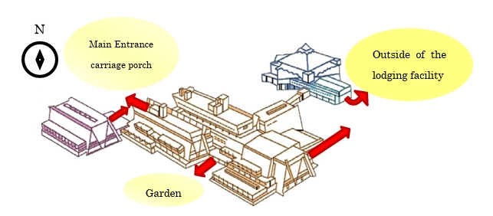
Emergency
<Primary Evacuation Site>
Notes:
In the event of an earthquake or fire, evacuation instructions will be broadcast in English over the PA system. All participants are requested to follow the instructions.

Slide 11
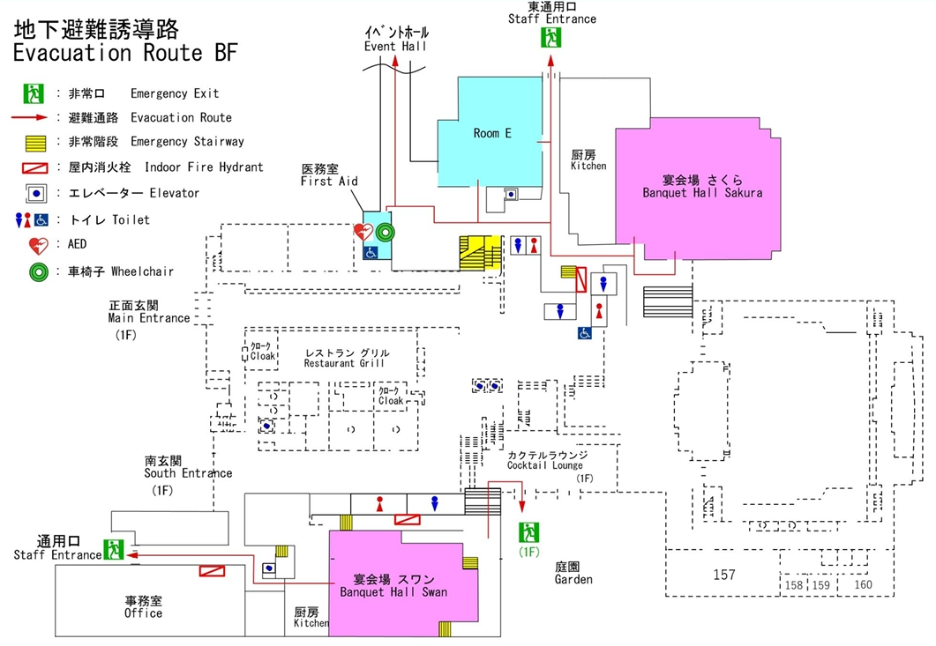
Evacuation Route BF

Slide 12
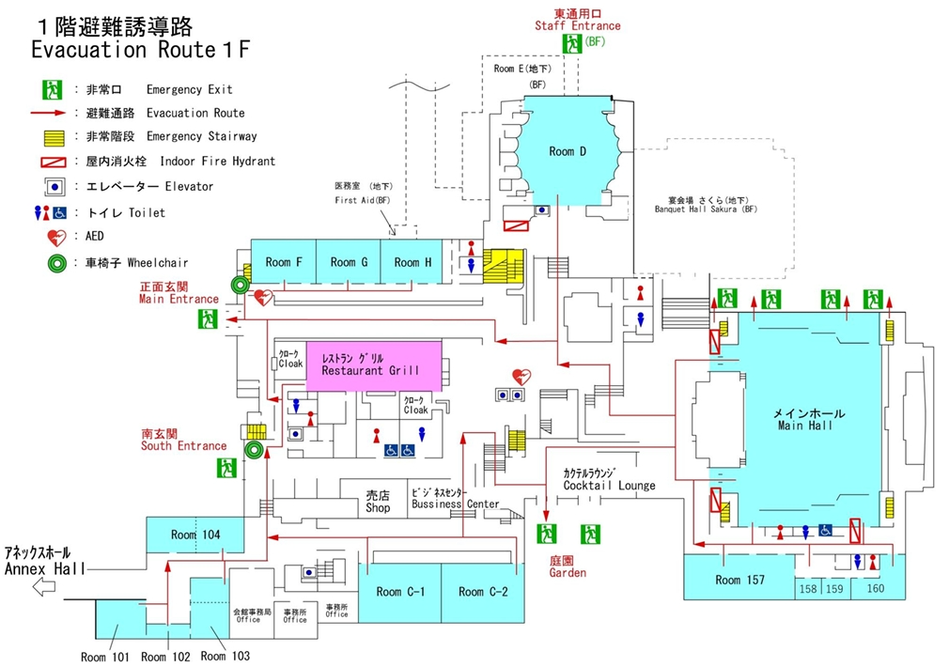
Evacuation Route 1F (Ground floor)

Slide 13
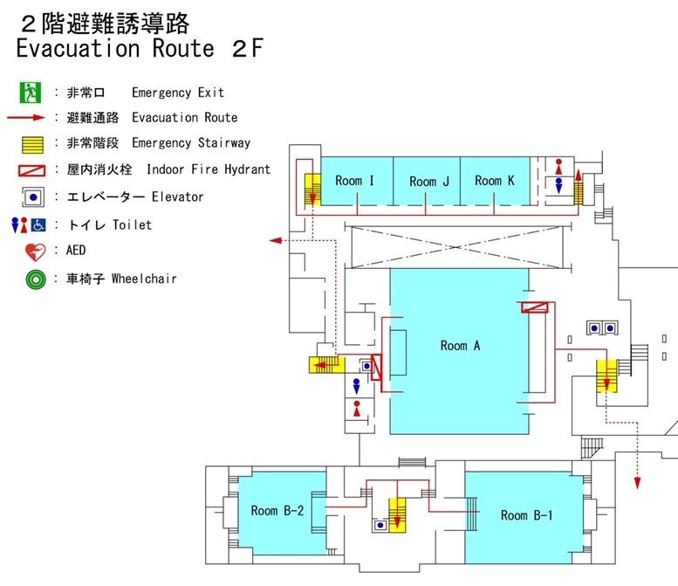
Evacuation Route 2F (1st floor)

Slide 14
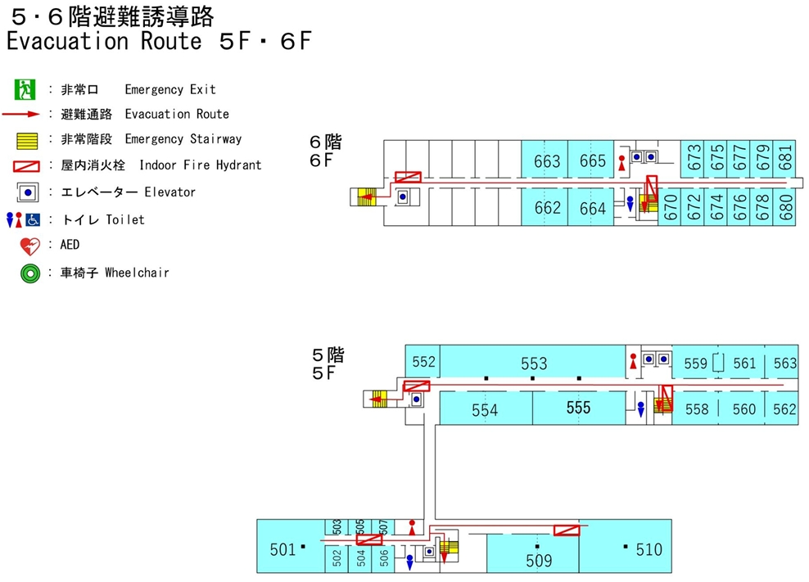
Evacuation Route 5F (4th floor)

Slide 15
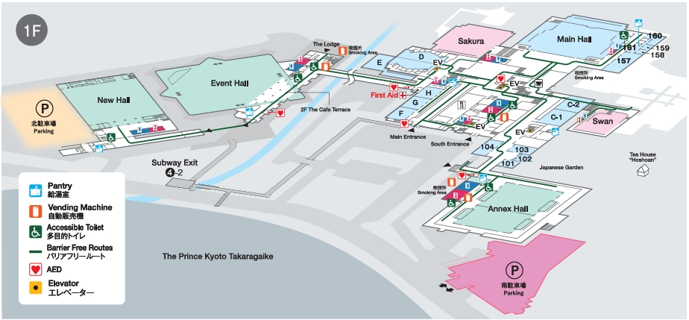
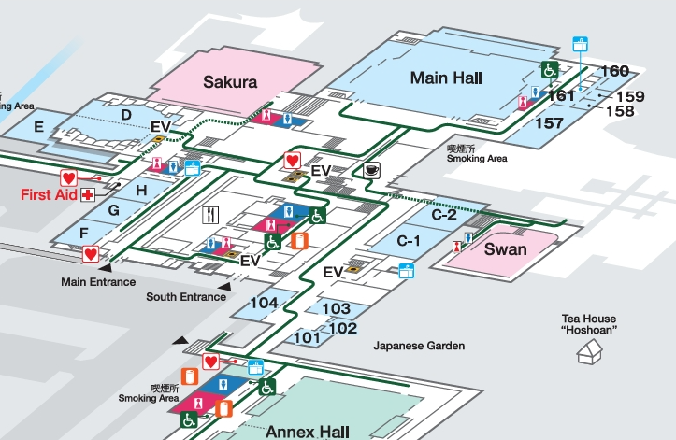

Smoking Area
*Smoking Is Prohibited Inside All Buildings
Smoking Area
Outside of Café
Near Annex Hall
The terrace at Sakura (ExMC dinner only)

Slide 16
Conference Staff
Name | E-mail
Minari KOGANE (Mr.) | kogane@tiis.or.jp
Sungmi JUNG (Ms.) | jung@tiis.or.jp
HoSu CHOI (Ms.) | -
YunJu LA (Ms.) | -

