Slide 1


Role of ESMA in
Raising the awareness & protecting the Consumers & Economy
Mohamed Saleh Badri
Acting Director General

Slide 2
UAE Population:
8.26 million
Up by 65% in four years
Bahrain
Oman
Arabian Gulf
Qatar
UAE Area:
83.600 sq.km
Abu Dhabi
United Arab Emirates
Oman
UAE Natural Resources:
Petroleum, Gas
10% world reserved Oil
5th in Gas reserve worldwide
Saudi Arabia
UAE Government: Federal with 7 states
UAE Capital: Abu Dhabi
GDP per capita:
$49.600
Up by 5%

Slide 3

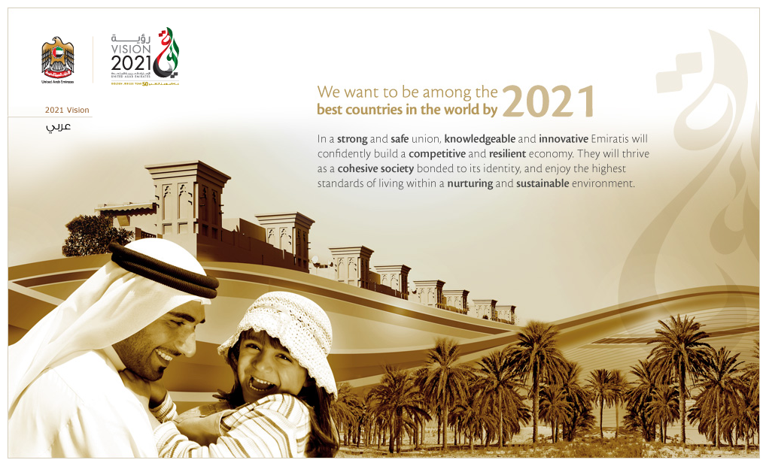
UAE Vision 2021

Slide 4
ESMA
Established as independent Authority as per Federal Law 28
Established as Reporting to UAE Cabinet
Established as Standardization Dept in Ministry of Finance
1977
2001
2009
(ESMA) is the sole authority for Quality, Metrology, and Standards in UAE
Also known as “National Standard Body (NSB)”
Our Vision : Regional Leader in Standardization

Slide 5


ESMA Mandates
PROVIDING SAFETY, & PROTECTING THE CONSUMER, ECONOMY & ENVIRONMENT
By ensuring that services & products (both locally manufactured or imported) are in conformity with the UAE standards

Slide 6


ESMA Mandates
SUPPORTING NATIONAL ECONOMY
By assisting national industry to enter international competition

Slide 7

ESMA Mandates
Programs to raise the awareness of civil society groups, individuals, government bodies, and business about the UAE standards and standardization activities.

Slide 8
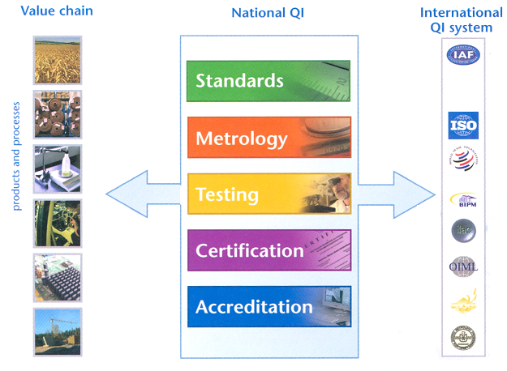
Quality Infrastructure
ESMA

Slide 9
Technical Regulation
Identify Essential Requirement
Implement the Standard & Guides
Review the requirement & System
Propose Technical Regulation & Agree on Program
Issue Technical Regulation
Issue Standards & Guides
Process for Issuing Technical Regulation
ESMA & Local Authorities
ESMA & Concerned Authority
Concerned Authority
ESMA
Cabinet
ESMA
Essential Requirements shall mean the minimum safety conditions which the product shall present regarding the level of protection for the health of persons, safety of persons and their properties, life and health of animals and plants, environment and the consumer,

Slide 10
Technical Regulation
Identify Essential Requirement
Implement the Standard & Guides
Review the requirement & System
Propose Technical Regulation & Agree on Program
Issue Technical Regulation
Issue Standards & Guides
ESMA & Local Authorities
ESMA & Concerned Authority
Concerned Authority
ESMA
Cabinet
ESMA
Benchmark
Formulate National Committee
Stakeholder Involvement
Draft Regulation
Conduct Awareness
Inform WTO
SDoC
Production Quality Assurance
Full Quality Assurance
Type Examination
Conformity to Type
Unit Verification
Low Risk
High Risk

Slide 11









Standards
Worldwide Standard Organizations

Slide 12
GSO
United Arab Emirates
Bahrain
Qatar
Saudi Arabia
Kuwait
Yemen

Slide 13

Police & Civil Defense
Customs (Federal & Locals)
Regulatory Bodies
Licensing Bodies
Ministry of Economy
National Lab
Health Authorities
Strategic Partners

Slide 14
Standards
NSB
Labs
Regulators
Formulate National Committee
International Standards are given priority for adoption
Mandatory Technical Regulations are notified to WTO and issued in official Gazette
ESMA runs Certification Program to verify the products
Manufacturer/ trader
Consumer Protection Agencies
Certification Bodies
R & D
Main Users

Slide 15
UAE Standards
Technical Regulation
Voluntary
600
20 in Oil & Gas
6000
5400
480 in Oil & Gas

Slide 16
Scope of ESMA
Safety
Quality
Metrology
?

Slide 17

UAE Energy Efficiency Standardization & Labeling (EESL)

Slide 18
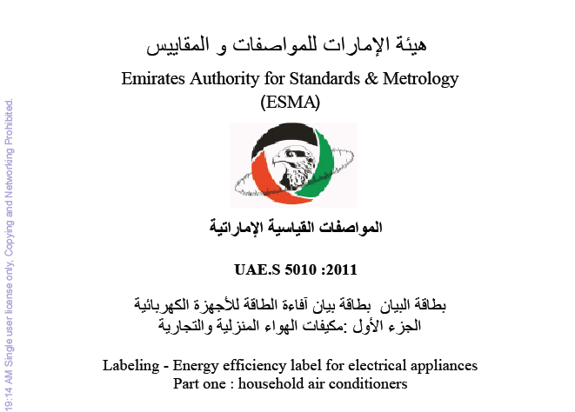
ESMA
بطاقة البيان- بطاقة بيان كفاءة الطاقة للأجهزة الكهربائية
الجزء الأول : مكيفات الهواء المنزلية و التجارية

Slide 19
MEP
4.5 |  |  |  |  |  | 5.0 |  |  |  |  |  | 5.9 |  |  |  |  |  |  |  |  |  | 6.5 |  |  |  |  |  |  |  | 7.0 |  | 7.5
5.50 | 5.60 | 6.00 | 6.10 | 6.20 | 6.30 | 7.00 | 7.10 | 7.20 | 7.30 | 7.40 | 7.50 | 8.00 | 8.10 | 8.20 | 8.30 | 8.40 | 8.50 | 8.60 | 8.70 | 8.80 | 8.90 | 9.00 | 9.10 | 9.20 | 9.30 | 9.40 | 9.50 | 9.60 | 9.70 | 10.00 | 10.30 | 11.25
EER
NOT TO BE TRADED IN UAE
1 STAR | 2 STAR | 3 STAR | 4 STAR | 5 STAR
1200 GWh
2500 GWh
)12.4%(
)27.2%(

Slide 20

PRIORITY PRODUCTS:
2011
Air Conditioning (Window & Non-Ducting Splits
2012
2013
Lamps & Washing Machines
Air Conditioning (Chillers & Ducted)

Slide 21


Global Recognition
Official UAE Certification Member Body
CB Scheme for Issuing & Recognizing Body

Slide 22
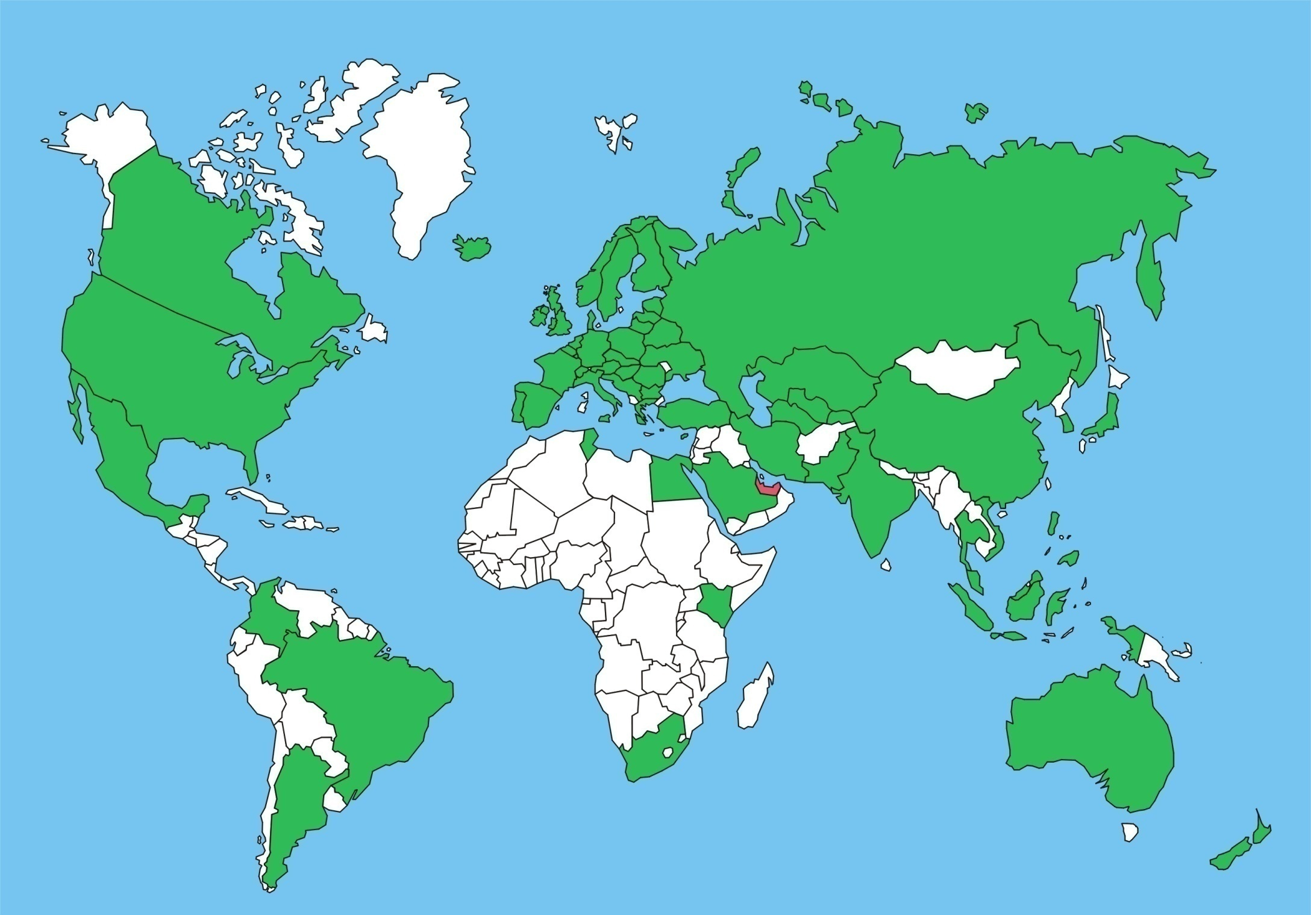
IECEE implemented countries
Austria – Belarus – Belgium – Bosnia & Herzegovina – Bulgaria – Colombia – Croatia – Czech republic – Denmark – Estonia – Finland – France – Germany – Greece – Hungary – Ireland – Italy – Latvia – Lithuania – Luxembourg – Malta – Netherlands – Norway – Poland – Portugal – Romania – Serbia and Montenegro – Slovakia – Slovenia – Spain – Sweden – Switzerland – Ukraine – United Kingdom - Cyprus
Iceland
Russian Federation
Canada
Europe
Kazakhstan
United States of America
Turkey
Iran
Korea
Pakistan
China
Japan
Mexico
Tunisia
Saudi Arabia
Egypt
India
Thailand
Vietnam
Malaysia
Colombia
Kenya
Indonesia
Brazil
UAE
Is an official Member now
Australia
South Africa
New Zealand
Argentina

Slide 23

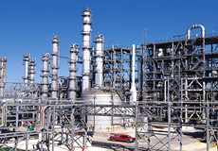
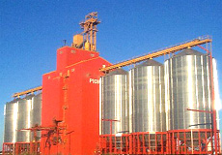
Road Map
Road Map
To Assure the Safe use of
Ex or Hazloc equipment in UAE
Benchmark & Awareness
Draft & Issue Regulation
Enforcement
Stakeholders meetings
Forming National Committee
Q1-2012
Q3-2012
Q1-2013
2014

Slide 24
www.esma.gov.ae
Thanks…

