Slide 1
IEC Conformity
Assessment
update for
IECEx MC
Shawn Paulsen
IEC Vice-President
CAB Chair
IECEx MC Meetings
Sept 26th, 2019
Dubai
INTERNATIONAL
ELECTROTECHNICAL
COMMISSION
Notes:
Thank you, ???
My name is Shawn Paulsen.
I am the Manager, Conformity Assessment at CSA Group and one of the Vice Presidents of the IEC as well as Chair of the IEC Conformity Assessment Board.
I thank you for this opportunity to speak here today and give an update of some of the IEC activities.

Slide 2
IEC Value Creation
Using standards = CA
Standards and CA are like two sides of a coin…
…together they bring maximum value
Standards + CA = Value
Notes:
This is now a well known slide, but needs to be constantly reminded.
The key message is still, standards and conformity assessment are like two sides of a coin… together standards and conformity assessment create value.

Slide 3
Vision:
IEC everywhere for a safer, more efficient world.
Notes:
The Vision Statement of the IEC is: IEC everywhere for a safer, more efficient world.
The IEC Masterplan outlines the vision and values of the IEC.

Slide 4
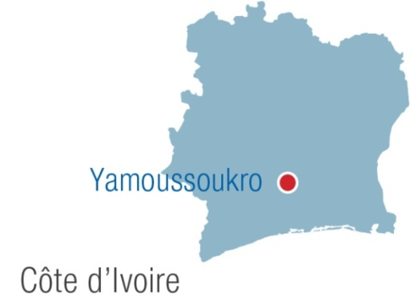
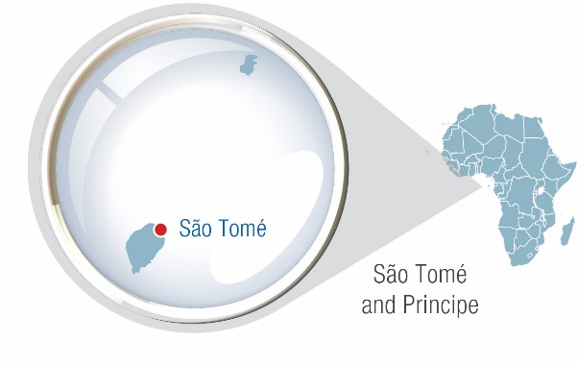
IEC family: 171 countries
86 Members 85 Affiliates
New members
New affiliate country
Notes:
The IEC brings together 173 countries that represent over 99% of world population and energy generation.
Since November 2015 when the IEC opened its 5th regional center, in Nairobi, Kenya, IEC now has offices on 6 continents.
In 2017 the IEC welcomed Peru as a full member and in 2018 welcomed Côte D’Yvoire and Bangladesh as Associate Members. Sao Tomé and Principe joined the Affiliate Country Programme.
Looking at the IEC, we currently have 84 Member Countries and 86 Affiliate country members. There are 204 TCs which operate 1450 WGs. The IEC family is also comprised of approximately 20000 experts and we have published over 10000 publications.
Looking at the CA side of IEC, we have the four IEC CA Systems that have issued over 1.0 Million certificates.

Slide 5
Strategic objectives
Market and societal relevance
Sustainable business model
Flexible organization
Agile operations
Notes:
Its strategic objectives are to ensure that the IEC remains relevant for markets and society, operates under a sustainable business model, and remains flexible and agile.

Slide 6
IEC and the UN SDGs
Notes:
The UN adopted the 17 Sustainable Development Goals in September 2015. IEC work directly impacts 12 of the 17 SDGs. Each SDG is a system of systems.
Many different IEC Standards impact energy efficiency outcomes, facilitate smart urban development or ensure the resilience of infrastructure in the face of disasters.
With our work we try to make the link between the very important technical work of the IEC and big societal challenges. For example: the UN adopted the 17 Sustainable Development Goals in September 2015. IEC work directly impacts 12 of the 17 SDGs. It provides the technical foundation for the whole energy chain and all the hardware that is driven by electricity. IEC work also helps achieve greater efficiencies. It helps improve the safety of devices, workers and populations, and it increases the resilience and long term viability of infrastructure.

Slide 7
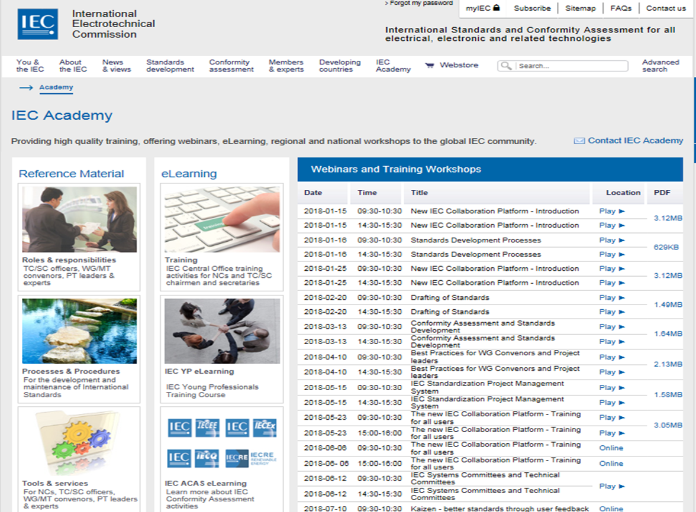
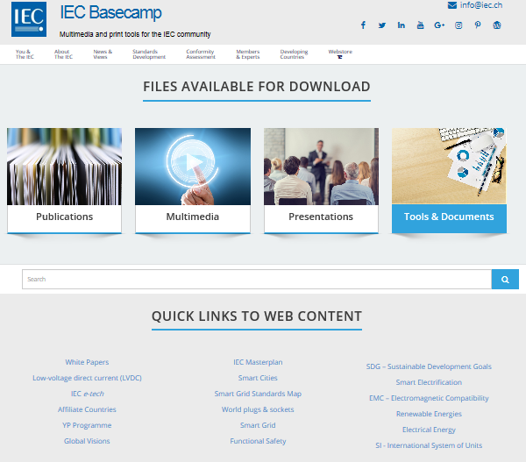
IEC Academy & Basecamp
http://www.iec.ch/academy/ https://basecamp.iec.ch/
Notes:
The IEC Academy provides access to IEC Reference Materials and high quality training, offering of webinars on Standards and Conformity Assessment, eLearning (such as the ACAS Modules), as well as regional and national workshops to the global IEC community. Webinars are recorded and made available on the Academy website for subsequent use as training material or other use.
The IEC Basecamp is your online resource for brochures, publications, annual reports, videos, presentations, media releases, give-aways, and more. All in one place. You will find an outline of the IEC organizational strategy and a summary of IEC work in individual technology sectors. Feel free to email order of the printed copies.
The IEC Academy and Basecamp can be found at the websites at the bottom of the screen.

Slide 8
IEC Structure
COUNCIL (C) (Full Member National Committees)
COUNCIL BOARD (CB)
Management Advisory Committees
EXECUTIVE COMMITTEE (EXCO) (IEC Officers)
CENTRAL OFFICE (The Executive)
SMB (STANDARDIZATION MANAGEMENT BOARD)
Management of International Standards work
MSB (MARKET STRATEGY BOARD)
Technology watch / market priorities
CAB (CONFORMITY ASSESSMENT BOARD)
Management of conformity assessment policies, activities and systems
Technical Committees
Special Working Groups
CAB Working Groups
Technical Advisory Committees
IECEE
IECEx
Strategic Groups
IECQ
Systems Work
IECRE
Notes:
The governing body of the IEC is the Council. It comprises all IEC Full Members – similar to shareholders in a company.
The Council Board works like the Board of Directors of a company and the ExCo brings together the executive directors.
The IEC has two main activities which are standards development and conformity assessment.
The SMB covers the standardization work of the IEC; the standards development activities are managed by the Standardization Management Board or SMB.
The Conformity Assessment Board, or CAB, manages the IEC Conformity Assessment activities including the IEC Conformity Assessment Systems;
The third Board of the IEC is the MSB and this Board is responsible for providing direct industry input helping to identify technology areas the IEC will have to cover in the short, medium and long-term to stay market relevant.
The IEC has two main activities which are standards development and conformity assessment.
The standards development activities are managed by the
Standardization Management Board or SMB.
While the conformity assessment activities are managed by the
Conformity Assessment Board or CAB.

Slide 9
IEC Conformity Assessment Board
IEC CAB
IEC’s policy-making board
All aspects of IEC’s CA activities
Oversight of the IEC CA Systems: IECEE, IECEx, IECQ, IECRE
CAB Working Groups
WGs 10, 11, 14, 17, 18
High Value Cooperation with International Bodies
ISO/CASCO – Development of CASCO Toolbox
IAF and ILAC – Cooperation with Accreditors
ITU, UNECE, OMIL, WTO, and so on
Notes:
As a reminder, the Conformity Assessment Board (CAB) is a policy making body of the IEC and is delegated by the Council through the Council Board to be responsible for the overall management of the conformity assessment activities of the IEC.
Today, the IEC’s operational CA activities are conducted through the four CA Systems.
The IEC’s CA strategic, policy, promotional and so on, work is mainly achieved through a number of CAB working groups with CO support.
The CAB also continues its valuable international cooperation and collaboration with organizations such as ISO/CASCO, ITU, UNECE, OIML, ILAC and IAF, and so on.

Slide 10
Major CAB Activities
Harmonized Basic Rules (HBR) for CA Systems
HBR ed.2.3
MPIP, CAB SWOT Analysis, CA Strategic Plan, CA Directives
Cyber security
UNECE United Nations Common Regulatory Objective (UN CRO) Guidelines for Cybersecurity
New scheme based on IEC 62351 for Energy Sector
Outreach to NCs
62443 Series as base standards
New CA Services Radar
Notes:
This year the various CAB working groups, ad hoc groups and task forces have been very productive.
CAB WG 11, who was responsible for developing the HBR, proposed an additional updates to IEC CA 01.
A number of recommendations were made by WG 11, including to modify the IEC CA 01 Basic Rules; to align the terminology for the CA Systems stakeholder surveys in the CA Systems’ and Council Board Surveys; requesting the CA Systems surveys be conducted every three years with the CB Survey, and adapting IECEE OD-G-2062, Guideline for IECEE Market Impact Analysis/Business Case for New and Existing IECEE Services, as a CAB level document, and a recommendation that requests for new work items on the standards development side to identify CA needs, which were all approved by CAB.
WG 10 has a number of tasks assigned to it, the most urgent of which was to develop implementation actions for the MPIP. Another key initiative under WG 10 is the development of a Conformity Assessment Directives document. The defining of the MPIP actions was completed by the WG 10 subgroup Task Force MPIP (TF MPIP), in February, and will be progressively updated according to the Council Board MPIP schedule.
WG 17 on cyber security is working with the UNECE on a generic systems-approach to CA for cybersecurity. A draft United Nations Common Regulatory Objective (UN CRO) Guidelines for Cybersecurity that had been jointly developed by IEC and UNECE, has been submitted to the UNECE WP.6 for discussion in their November meetings in Geneva. CAB WG 17 will continue to have input on this Common Regulatory Objective and was endorsed by CAB to continue this important work.
WG 17 made a number of recommendations, including a proposal that IECEE investigate the market need and viability for a cybersecurity scheme based on the IEC 62351 series for the Energy Sector; that a team be established to create a strong communication plan involving the IEC community and that this extend to strong involvement of and by the National Committees to engage stakeholders, including Regulators. A Decision was also taken where CAB will recommend to SMB that the IEC 62443 series of standards become base (horizontal) standards. Each of these recommendations was approved by CAB.
Another CAB subgroup activity is WG 18, now renamed the New CA Service Radar, which is a forward looking radar to spot global CA needs of the near future. A list of topics have been converted into an Excel spreadsheet and this is now available on the CAB website. CAB approved a bidirectional feedback process to keep the CA Radar list up-to-date; and approved a request to the CA Systems that the bidirectional feedback process become a standing item in CA Systems’ Management Committee meetings.

Slide 11
Major CAB Activities
FinCom
Lessons Learned Analysis
Stakeholder Survey Reports
IEC Board Self-Assessment
IEC/ILAC/IAF Steering Committee
IEC Regulator Forum
ACAS: Affiliate Conformity Assessment Status
E-learning online – IECEE, IECEx, IECRE, and IECQ
World view of CA & QI
Notes:
In other CAB Activities.
ahG FinCom is made up of the four CA System Treasurers, Executive Secretaries and the CAB Secretary, was established in June and given three tasks, the main one to review the FinCom requirements concerning three year budgets, and a second one, to follow closely the Masterplan Implementation Plan (MPIP) financial requirements. The third task was to analyze CA Systems Management Committee costs for hosting these meetings by Member Body Countries and make recommendations on how to offset these costs. CAB approved recommendations concerning the development of a Management Committee Guideline document for hosting IEC CA Systems Management Committee meetings, and the concept of dedicated meeting funds created by each CA System to cover portions of their annual Management Committee meetings. CAB also agreed that the 2 year budget outlook was there for information only and did not require formal approval by CAB.
Last year, CAB requested an analysis and report on lessons learned from the IECRE experience, so that this experience could be captured and not lost to future IEC participants. This report was presented at the CAB meetings and included a number of suggestions for CAB consideration. CAB established an ahG to extract the essential lessons from the document and create recommendations for CAB consideration and then integrate them into the CA Directives and/or IEC CA Policy document (as appropriate).
CAB noting that each of the CA Systems have now generated stakeholder survey reports, as required by IEC CA 01 edition 2.1 and later, and as requested by the Council Board. CAB tasked WG 11 with reviewing the summaries, and with considering the need for additional columns or information, and providing a report to CAB for its June 2019 meeting.
The three IEC Boards will undertake a self assessment following our Shanghai meeting, similar to the CB Self Assessment has conducted on itself. We will seek feedback on a number of areas such as our effectiveness, membership, board meetings, operations, performance, and collaborations with the other Boards.
An IEC/ILAC/IAF Steering Committee is discussing topics related to unified assessments within the IEC CA Systems, the Accreditation Body (AB) assessments, the common interpretation of ISO/IEC 17025 and ISO/IEC 17065, and referencing ISO/IEC conformity assessment standards. A joint Decision was taken at this meeting to ensure that when conformity assessment standards are referenced that both organizations shall be included.
An issue concerning three IAF resolutions 2016-17, 2017-19 and 2018-13 (see document CAB/1844/DC), has been a topic of concern for IEC and has provoked significant discussion with IAF. This issue has put the Memorandum of Understanding between IEC, ILAC and IAF in jeopardy. CAB formed a Task Force (TF) to review this issue (and larger relationship issues with IAF and ILAC) and to draft an initial response to the email from the IAF Chair and identify courses of action which could include withdrawal from the IEC/ILAC/IAF MoU.
Recognizing the need to raise awareness and provide a better understanding of the IEC’s CA services within Developing Countries, or, in IEC terminology, the Affiliate Conformity Assessment Status, or ACAS, was launched in 2013. As part of ACAS, the IEC has created online e-learning modules. There are approximately 54 e-learning units online covering the 4 IEC CA Systems, IECEE, IECEx, IECRE and IECQ.
A final series of units is being developed covering a World View of Conformity Assessment including explanations of quality infrastructure and the global players therein.

Slide 12
Major CAB Activities
Centralized Document System
IECRE Improvement Plan
CB Scheme for Radio
Bilateral Agreements
Notes:
In other CAB Activities.
The centralized document handling and online voting and commenting system was a foundational project that had already been deployed across the IEC
and remained only to be deployed to the IEC CA Systems. Its deployment for IECEE and IECRE was planned for completion in Q4 2019, but deployment to IECEx and IECQ was as yet unscheduled.
CAB held a Special Meeting outside of the normal CAB meeting for CAB Members only to discuss a recently submitted IECRE Improvement Plan that had been requested by the IEC General Secretary. The Improvement Plan was meant to be a detailed document to explain how the IECRE intends to implement sustainable growth for the future. The document lacked a business plan and growth strategy and mainly focused on balancing the budgets through expenditure reductions. CAB reviewed the document and did not support the content. CAB therefore decided to create a CAB Task Force (TF) to assist the IECRE membership in the development of a new IECRE Improvement Plan consisting of a market analysis and intelligence from the members to create a strategic business plan for sustainable revenue growth and promotion of the System and to submit formal recommendations to CAB at its Shanghai meeting.
The strong development of IoT and wireless products is now obvious at a worldwide scale.
Products need to comply with various regulatory requirements in diverse countries.
Most of these regulations are using international standards from CISPR and / or ETSI, or standards
based on these ones.
The main issue today for manufacturers is the time and the process needed to obtain all the approvals.
The principle to have a "Radio CB Scheme" could answer most of the issues for manufacturers and
could also generate new revenue stream for the IEC CA stakeholders. The French National Committee is requesting the CAB to study, in collaboration with IECEE, the launch of such a "Radio CB Scheme".
More and more bilateral governmental agreements are signed to facilitate free world-wide trade.
These bilateral agreements may foresee the mutual recognition of CA results in their countries.
It is an opportunity for the IEC to motivate its NCs to encourage their respective governments in having bilateral governmental agreements always foreseen in the electrotechnical field with the acceptance of test results of the IEC CA Systems as an option.

Slide 13
CAB Publications
CAB Policy
Good Working Practice
Harmonized Basic Rules Ed. 2.3
Promotional Matrix
Peer Assessment Fundamentals
Risk Management Grid
Systems Approach to CA
Vademecum
CABPUB Procedures
Notes:
CAB has been very active in publishing many standing documents. These documents are publically available on the CAB Section of the IEC Website.

Slide 14
IEC Board Collaboration
Standards & Conformity Assessment Cooperation
Guidance to TCs/SCs for CA when writing standards
IEC CA Systems feedback loop from CA to SD
Liaisons
SG 11 Hot Topics & CAB New CA Services Radar
SG13 Working with Consortia
CAB, SMB, MSB collaboration on Market Evaluation
Notes:
As we can see in this slide, CAB and SMB have worked together to address key CA issues and we continue to work together with many liaison activities.
The three Boards are also collaborating on the identification of new technology areas and then looking at standards and conformity solutions and potential gaps.
By working together the SMB, CAB, and the MSB can create the most value for IEC and its community.

Slide 15
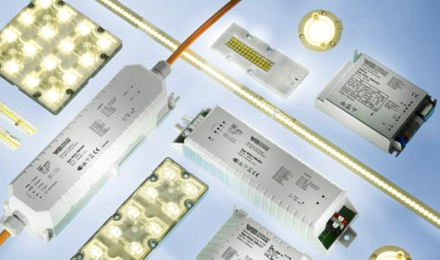
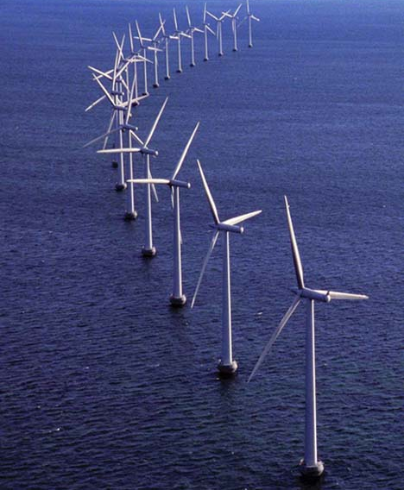
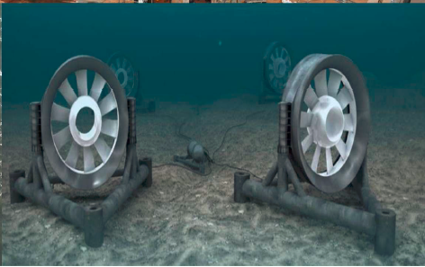
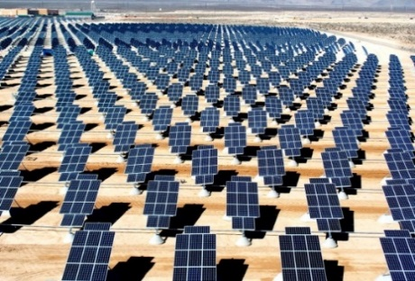
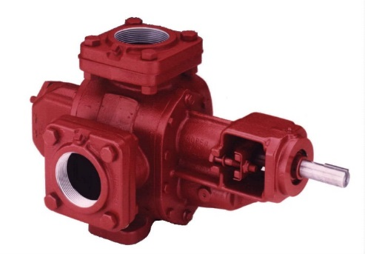
IEC CA Systems - Recent Areas and Technology Fields
Cybersecurity/Functional Safety
LED Lighting + Systems
Aerospace Counterfeit Avoidance
Marine Installations
Industrial Automation
Wind Turbines
Mechanical Equipment, Components + Systems
ISO 80079 series
PV Solar
Notes:
I would now like to provide a quick update of the activities of the four IEC conformity assessment Systems. The IEC has four global conformity assessment systems which are continuing to serve the market and showing growth. IEC CA Systems are growing exponentially as more and more countries are starting to understand that testing and certification is an integral part of a country’s quality infrastructure.
IECEE – for electrical and electronic products.
IECEE has developed a testing and certification programme to address the need for CA solutions related to cyber security and functional safety in the industrial automation sector and is putting in place a programme for the certification of personnel competency in this area. They are also analysing programs for ITU lab qualification, energy efficiency under the UN U4E for lighting products, and Industrial Communications Networks.
IECEx – for all verification needs of the Ex industry, or, explosive atmospheres sector.
IECEx has put in place a certification scheme for non-electrical equipment and protective systems for explosive atmospheres which is enjoying high demand. The IECEx Certified Persons Scheme continued to show strongest growth and already surpassed the milestone level of 1000 certified persons. There is now over 2400 certified persons. The IECEx has also introduced to its Ex Equipment scheme, certification of the mechanical equipment connected to the electrotechnical equipment already covered by the scheme. This has showed major growth over the last year.
IECQ – for electronic components and supplier quality management.
The IECQ LED lighting scheme has successfully issued a series of certificates. IECQ is also expanding beyond avionics into automotive supply chain verification. The IECQ has established a new WG to look at potential areas for supply chain verification for nuclear industry components. Noting that 60 Nuclear plants are currently under construction with over 150 new plants being designed. This program could also cover aged component replacement. IECQ also setup a new WG to review the possibility of providing certification against ISO/IEC 27001 series of standards. IECQ is considering a request from TC 105 – Fuel Cells for IECQ to provide a verification programme according to ISO 14025 to evaluate the environmental performance against requirements established by TC 105 and prepare a declaration file.
IECRE – for renewable energy in the wind energy, marine energy and PV solar energy sectors.
IECRE - over the last year a number of successful assessments have been completed on new RECBs, RETLs, and REIBs. IECRE has issued 50 certificates in the Wind Energy sector and has issued the first solar PV certificate and the marine sector is ready for testing and certification as soon as the first standards are finalized.

Slide 16
Thank you for your attention
IEC CAB website www.iec.ch/cab
IECEE website www.iecee.org
IECQ website www.iecq.org
IECEx website www.iecex.com
IECRE website www.iecre.org
Shawn Paulsen
IEC Vice-President
CAB Chair
IECEx MC Meetngs
Sept. 26th, 2019
Dubai
INTERNATIONAL
ELECTROTECHNICAL
COMMISSION
Notes:
I hope this brief update was useful.
As you can see, we are busy in many areas.
Thank you for your attention.

