Slide 1
ExTAG WG 10
PTB Ex Proficiency Testing Scheme
“Final results of the pilot phase
programs ‚d‘ and ‚i‘
and future PT activities”
Report during the ExTAG meeting 2012, Calgary, CA
Dr Uwe Klausmeyer (deputy: Dr Ulrich Johannsmeyer)
Convenor of the ExTAG WG 10 „Proficiency Testing“

Slide 2
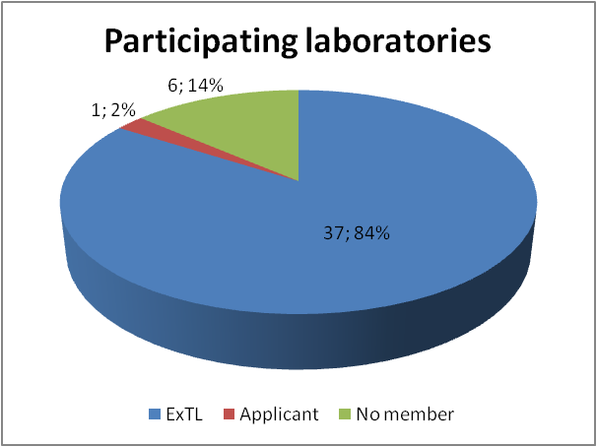

Participation within the pilot programs
Number of participating labora-tories of the both programs : 44
Number of laboratories which have the status of an ExTL: 37
Number of laboratories which have the status of an ExTL applicant: 1
Number of laboratories which are no member in the IECEx System: 6
Number of participants in the Workshop: 57
1

Slide 3
Test Round “d” and “i”
Test Round “d“
(Flameproof Enclosures)
Test Round “i“
(Intrinsic Safety)
Comparison quantity: Explosion Pressure (reference pressure)
Comparison quantity: Number of contacts up to ignition
Principle: Measuring the explosion pressure after ignition of explosive gas-air mixture in explosion vessels with four configurations
Principle: Measuring the number of contacts up to ignition in explosive gas-air mixture with STA
Scope: 4 configurations, 2 explosive gas-air mixtures, 5 ignitions for each configuration and mixture
Scope: 12 circuits, 20 ignitions for each circuit.
4

Slide 4
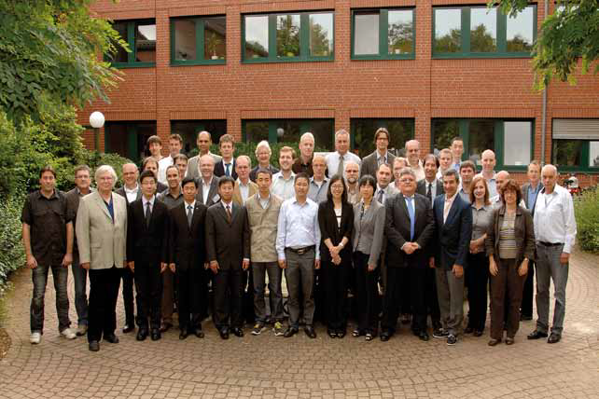
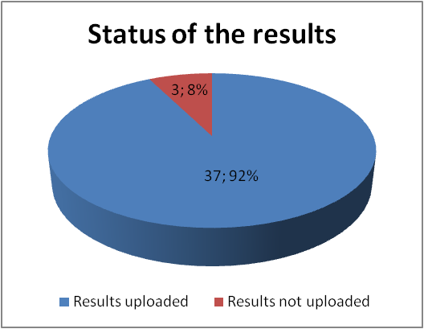
Participation Test Round “d”
Number of participating laboratories of Test Round “d”: 40
Uploaded results of Phase I: 35
Uploaded results of Phase II: 37
Number of new uploaded test results in Phase II: 16
Number of participants in Workshop - part d: 33
2

Slide 5
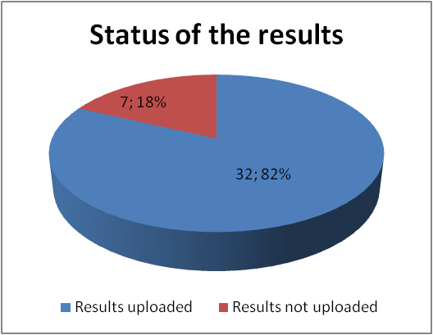
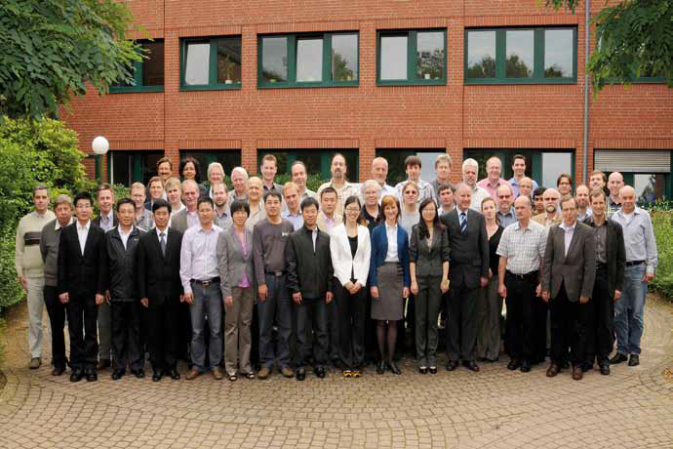
Participation Test Round “i”
Number of participating laboratories in Test Round “i”: 39
Uploaded results of Phase I: 27
Uploaded results of Phase II: 32
5 laboratories improved their test results in Phase II
Number of participants in Workshop – part i: 36
3

Slide 6
Results of Test Round “d”
Comparison of the results of Phase I and Phase II
 |  |  | Phase I |  | Phase II
Configuration | Gas | Position of pressure sensor | Assigned value X | Standard deviation of assigned value | Assigned value X | Standard deviation of assigned value
a | Ethylene | Side of ignition | 7,04 | 0,86 | 7,24 | 0,67
a | Ethylene | Opposite side | 7,19 | 0,79 | 7,39 | 0,59
a | Hydrogen | Side of ignition | 6,43 | 0,46 | 6,47 | 0,30
a | Hydrogen | Opposite side | 6,50 | 0,43 | 6,53 | 0,31
b | Ethylene | Side of ignition | 6,72 | 0,98 | 6,88 | 0,77
b | Ethylene | Opposite side | 7,11 | 0,56 | 7,16 | 0,54
b | Hydrogen | Side of ignition | 6,21 | 0,60 | 6,21 | 0,40
b | Hydrogen | Opposite side | 6,34 | 0,48 | 6,32 | 0,38
c | Ethylene | Side of ignition | 6,08 | 1,13 | 6,36 | 0,84
c | Ethylene | Opposite side | 11,66 | 1,73 | 11,88 | 1,18
c | Hydrogen | Side of ignition | 6,24 | 0,70 | 6,31 | 0,47
c | Hydrogen | Opposite side | 13,12 | 2,50 | 12,93 | 1,82
d | Ethylene | Opposite side | 15,74 | 1,73 | 15,75 | 1,27
d | Ethylene | Side of ignition | 5,83 | 0,67 | 5,92 | 0,57
d | Hydrogen | Opposite side | 14,01 | 2,68 | 13,79 | 1,86
d | Hydrogen | Side of ignition | 5,80 | 0,45 | 5,94 | 0,36
5

Slide 7
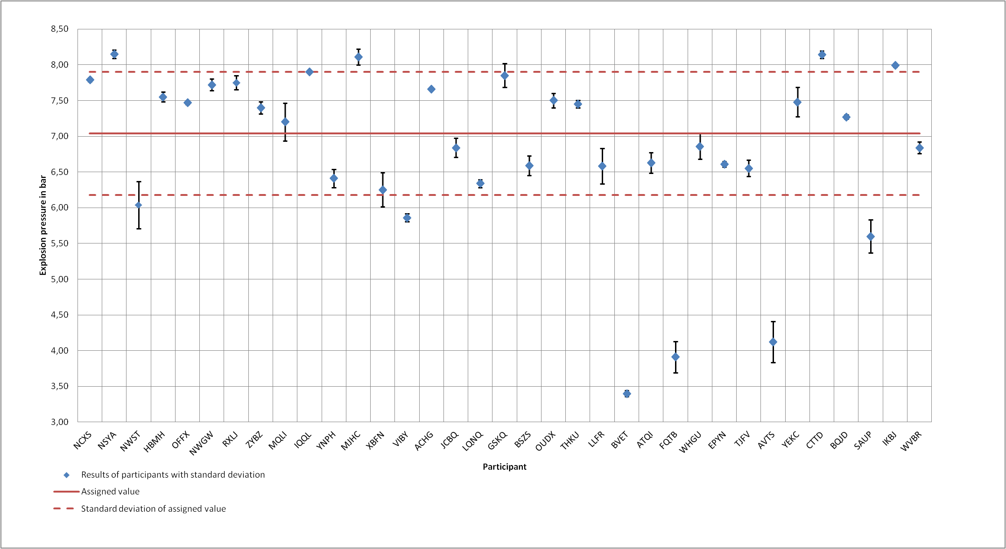
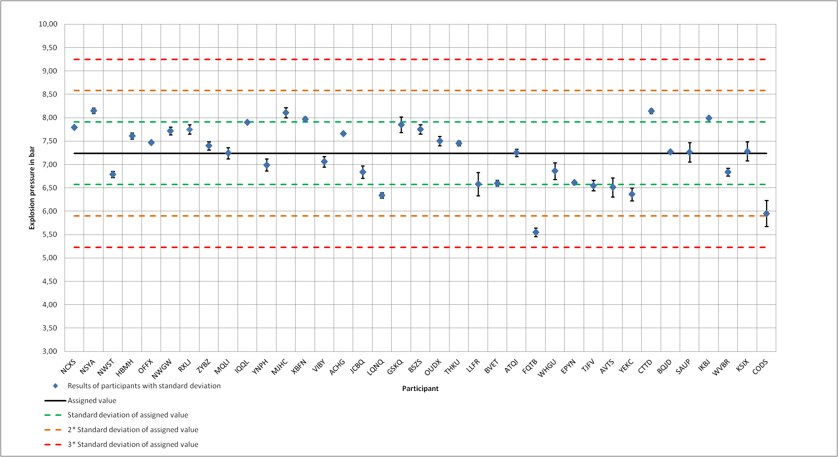
Results of Test Round “d”
Configuration a); Side 1; Ethylene 8 % ± 0.5 %
6

Slide 8
Results of Test Round “i”
Comparison of the results of Phase I and Phase II
>>1000
7
Notes:
8

Slide 9
Results of Test Round “i”
Circuit 4: capacitive circuit
Ca. 1000 NoC
8
Notes:
9

Slide 10
PTB Survey Results (33 of 44 laboratories answered) for the PTB Ex PT pilot program
(1) Overall performance of the pilot programs “d” and “i” in relation to
a) concept [ 9.0]
b) processing [ 8.9 ]
c) support [ 9.0 ]
d) reporting [ 9.0 ]
(10 = very good – 0 = very poor)
(2) Overall performance of the workshops (only if your laboratory has participated)
a) “d” [ 9.2 ]
b) “i” [ 9.3 ]
(10 = very good – 0 = very poor)
(3) How long was the estimated in house operation and processing time (in hours) you have spent for:
a) program “d” [ 78 ]
b) program “i” [ 78 ]
c) was this time too long [ 12/33 ], appropriate [ 21/33 ]
9

Slide 11
PTB Survey for the PTB Ex PT pilot program
(4) Did you feel that the pilot programs caused a certain impact on your daily in house procedures [ 4.9 ]
(10 = strong impact – 0 = no impact)
(5) Would you join a PTB Ex PT scheme under the condition that you have to pay fees
a) on a long term basis and all in one fee for the entire IEC 60079 standard group CHF 5,000 per year, assuming that the PTB Ex PT scheme provides full compliance with ISO/IEC 17043 and enjoys recognition by accreditation bodies resp. IECEx peer assessors? (yes/no) [ 12/33 Yes ]
b) on a short term or case by case basis? (yes/no) [ 26/33 YES ].
c) no interest, other schemes have been selected already (yes/no) [ 2/33 Yes ]
10

Slide 12
PTB Survey for the PTB Ex PT pilot program
(6) Which future programs would you welcome with which priority:
a) temperature classing (IEC 60079-0, cl. 26.5) [ 7.3 ]
b) propagation tests (IEC 60079-1, cl. 15.2) [ 6.9 ]
c) conformity assessment projects (“d” motors, “e” lighting fixtures) [ 5.8 ]
d) [own proposals]:
(7) Would you appreciate to get offered (in conjunction with the Ex PT programs)
a) workshops (yes/no) [ 29/33 YES ]
b) practice courses (yes/no) [ 28/33 YES ]
IEC 60079-0, cl. 7.4.2 and future IEC 60079-32, electrostatic tests
IEC 60079-0, cl. 26.13 Surface resistance
IEC 60079-0, cl. 26.14 Measurement of capacitance
IEC 60079-0, cl. 26.4.2 Resistance to impact at low temperatures for non-metallic enclosures
IEC 60079-0, cl. 26.4.5 IP 6X with underpressure
IEC 60079-0, cl. 26.5.3 Small component ignition test
IEC 60079-11, Annex E Crowbar – Transient energy test
IEC 60079-7, cl. 4.3 and 4.4; IEC 60079-11, cl. 6.3; 60079-15, cl. 6.4, clearances, creepage distances & separations
i tests with one or two circuits
lithium polymer cell phone battery and Tests for cells and batteries
11

Slide 13
Conclusions and future agenda
Evaluation of the feed back survey, answers to the laboratories soon
„Best Practice“ papers for ‚d‘ and ‚i‘ testing will be published in Oct. 2012
PTB has decided to offer proficiency testing programs as
„PTB Ex Proficiency Testing Scheme“ on a permanent basis,
providing a compliance list (Febr. 2013) with the ISO/IEC 17043,
but without accreditation, as governmental not-for-profit provider
The „PTB Ex PT Scheme“ will cooperate with IECEx closely via
ExTAG WG 10 (see ExTAG/269/R from the ExTAG 2012 agenda)
Each year two programs will be offered:
- they will be less time consuming than the pilot programs
in order to minimize inhouse workload caused by the programs
- after the programs a „Best Practice“ paper will be published
Future programs are presently under preparation:
- temperature classing IEC 60079-0
- propagation tests IEC 60079-1
ExTLs should be aware about some pressure to join PT programs:
- ISO/IEC 17025, cl. 4.4.1, 4.12.2, 4.15.1, 5.9.1 requiring PT
- IECEx draft Business Plan 2013-2016, cl. 10.4, 12.
- each PT provider for the IEC 60079-0 group is welcome (not only PTB)

